Slide 1


ROP and CFI
SE3331-1 (2022 Fall)
IPADS, Shanghai Jiao Tong University
https://www.sjtu.edu.cn
Notes:
Credits to Mike Freedman (COS 461) and others.

Slide 2
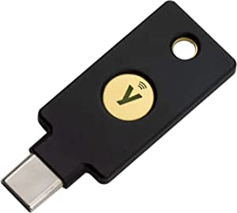
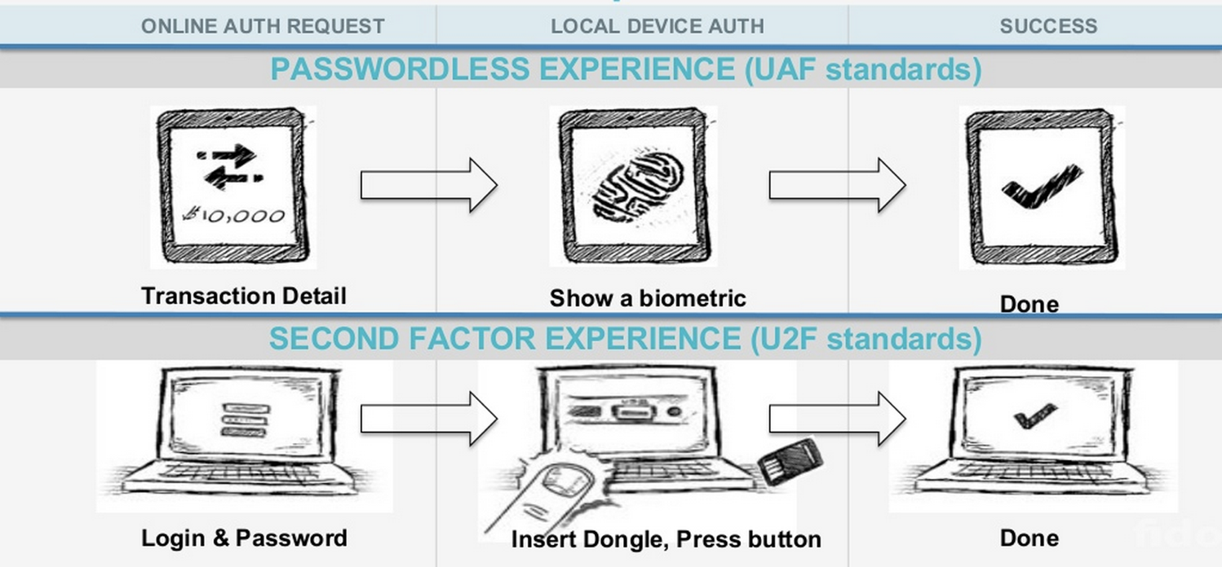
Review: Tech 7: FIDO: Replace the Password
FIDO:fast identity online

Slide 3
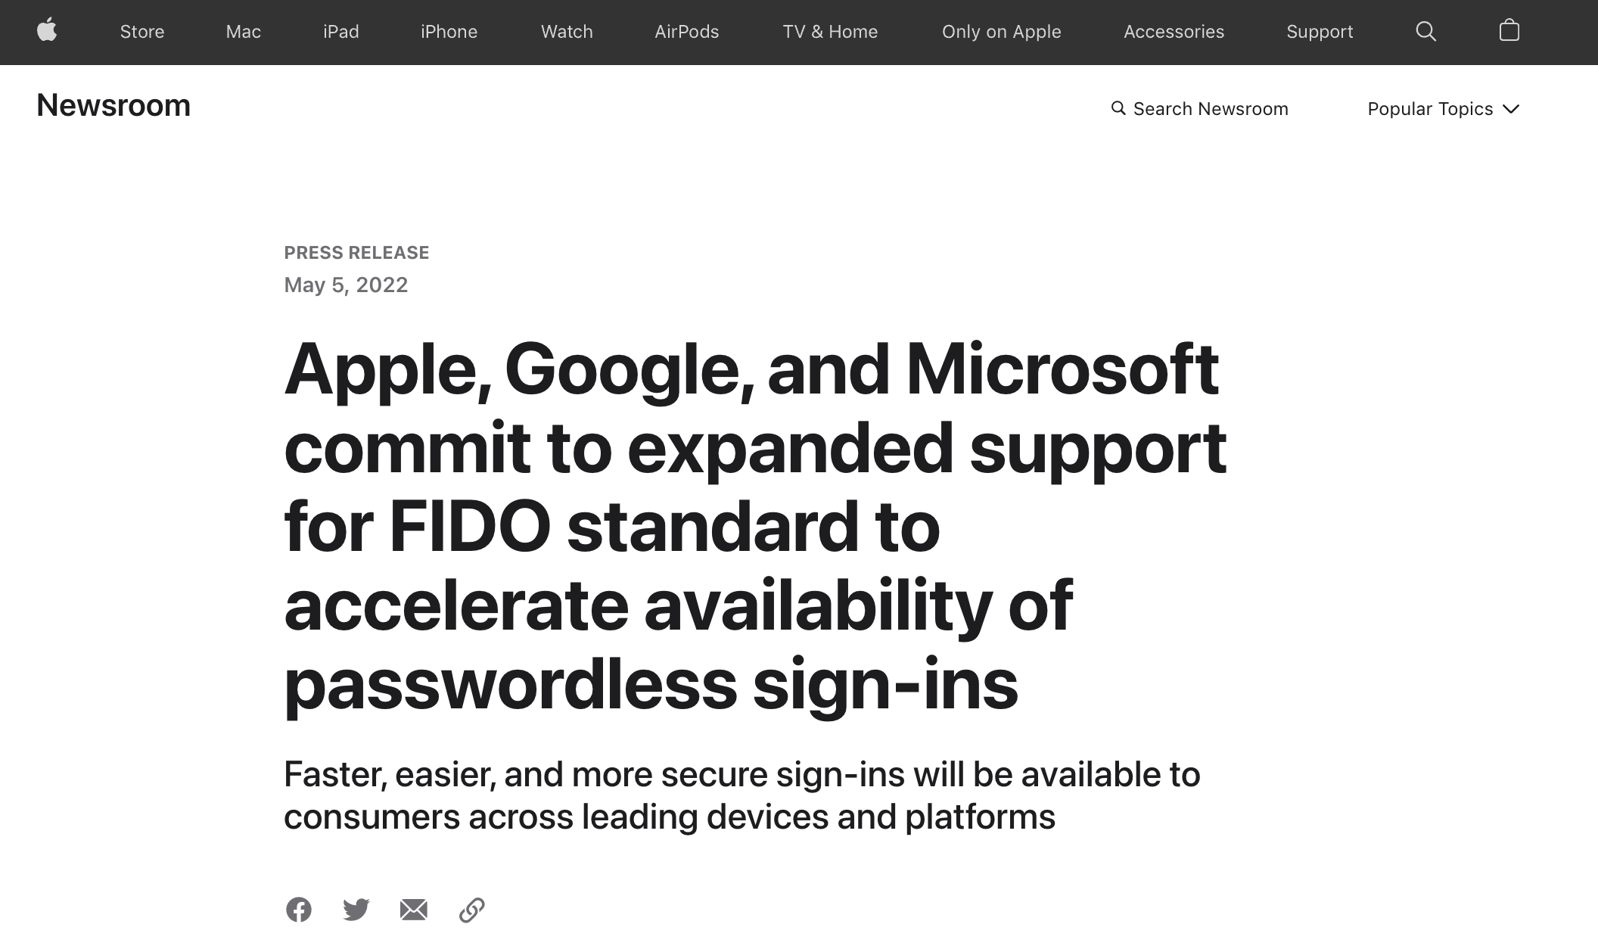

Slide 4
Three Bindings
private/public key只具有加密的语义，而不具有”人”的语义，所以一个攻击者是可以直接用截取的key进行窃取数据，所以为了更安全，需要添加新的binding，而这个binding是运行在一个独立于设备主操作系统的一个安全的操作系统上面的，并且这个binding是不会被备份以及转移的。
Fingerprint
User ID
Private key
Publish key
Phone
Server
Secure by hardware (e.g., Enclave)
Secure by isolation
public key一般是在用户在一个网站注册一个新的账号的时候会自动生成的

Slide 5
Bootstrapping
在设置密码/修改密码的时候会发送一个URL验证邮件，这些URL邮件一般都具有较短的生命周期，是因为这种URL一般都附带有一个根据用户信息生成的随机token，但是这个token由于生成算法的问题，很可能被枚举得到，所以设置过期时间是为了防止出现有attacker通过枚举得到答案而进行攻击。
How to initially set a password for an account?
If adversary can subvert this process, cannot rely on much else
MIT: admissions office vets each student, hands out account codes
Many web sites: anyone with an email can create a new account(引入binding)
Changing password (e.g., after compromise)
Need some additional mechanism to differentiate user vs. attacker
MIT: walk over to accounts office, show ID, admin can reset password
Many sites: additional "security" questions used to reset password
Password bootstrap / reset mechanisms are part of the security system
Can sometimes be weaker than the password mechanisms
Sarah Palin's Yahoo account was compromised by guessing security Q's
Personal information can be easy to find online

Slide 6
Security Principles

Slide 7
Principle of Least Privilege
Deal with bugs / incomplete mediation
Any component that can arbitrarily access a resource must invoke the guard
If component has a bug or design mistake, can lead to incomplete mediation
General plan: reduce the number of components that must invoke the guard
E.g., arrange for DB server to check permissions on records returned, then security does not depend as much on lookup.cgi

Slide 8
Least Trust
Privileged components are "trusted"
Trusted is bad: you are in trouble if a trusted component breaks
Untrusted components are good: does not matter if they break
Good design has few trusted components, other things do not affect security

Slide 9
Users Make Mistakes
Social engineering, phishing attacks
How many of you really read the permission acquired by apps during installing?
Good idea: threat model should not assume users are perfect

Slide 10
Cost of Security
Security VS. Availability
E.g., system requires frequent password changes -> users may write them down
How far should a teacher go to protect the exam file?
Put the file on a separate computer, to avoid sharing a file system?
Disconnect computer from the network, to avoid remotely exploitable OS bugs?
Put the server into a separate machine room?
Get a guard to physically protect the machine room?
...
Good idea: cost of security mechanism should be commensurate with value
Notes:
Most security goals/policies not infinitely valuable, can tolerate attacks.
Security mechanisms can be expensive (e.g., wasted user time).

Slide 12

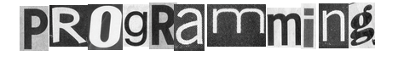

Slide 13
Review: Stack Buffer Overflow
A Typical Buffer Overflow Attack
Inject malicious code in buffer
E.g., shellcode
Overwrite return address to buffer
Once return, the malicious code runs
0101011010111010111010
return addr
ebp
saved ebp
01101101010101010101011010101010101011101010
void function(char *str) {
char buf[16];
strcpy(buf,str);
}
buf

Slide 14
Shellcode Sample to Open "/bin/sh" (21 bytes)
int main(){
char sc[] = "\x6a\x0b" // push byte 0xb
"\x58" // pop eax (now eax=0xb)
"\x99" // cdtq(convert double to quard)
"\x52" // push edx (now edx=0)
"\x68\x2f\x2f\x73\x68" // push dword 0x68732f2f
"\x68\x2f\x62\x69\x6e" // push dword 0x6e69622f
"\x89\xe3" // mov ebx, esp
"\x31\xc9" // xor ecx, ecx (now ecx=0)
"\xcd\x80"; // int 0x80
((void (*)()) sc)();
}
More can be found on https://www.exploit-db.com
Notes:
Convert Double to Quad的缩写，意为将双字数据扩展为四字。 该指令先把edx的每一位置成eax的最高位（若eax>=0x80000000, 则edx=0xFFFFFFFF；若eax<0x80000000，则edx=0x00000000） ，再把edx扩展为eax的高位。
68: h
73: s
2f: /
2f: /
6e: n
69: i
62: b
2f: /

Slide 15
Defense: DEP (Data Execution Prevention)
Execute Code(.text), not Data
Data areas marked non-executable
Stack marked non-executable
Heap marked non-executable
Enforced by hardware
NX: Non-eXecutable (the name on hardware)
You can load your shellcode in the stack or the heap…but you can't jump to it to execute

Slide 16
Attack: Code Reuse (instead of inject) Attack
ROP: Return-oriented Programming
Find code gadgets in existed code base
Usually 1-3 instructions, ends with 'ret'
In libc and application, intended and unintended
Push address of gadgets on the stack
Leverage 'ret' at the end of gadget to connect each code gadgets
No code injection
0101011010
0101011010
0101011010
return addr
0101011010
saved ebp
0101011010
return-oriented是因为要通过return将多个不连续的gadgets连接起来，因为要用于攻击的代码一般不会出现在原始正常的代码中。
0101011010
0101011010

Slide 17
Code Execution – The ROP Way
Mem[v2] = v1
a₃
v₂
a₂
v₁
Desired Logic
Stack
mov %eax v1;
mov %ebx v2;
mov [%ebx], %eax
a₁: pop eax; ret
a₂: pop ebx; ret
a₃: mov [ebx], eax
pop与mov功能的等价性。

Slide 18
Code Execution – ROP Way
a₃
v₂
a₂
v₁
a₁
…
argv
argc
return addr
caller's ebp
buf (64 bytes)
argv[1]
buf
Mem[v2] = v1
Desired Shellcode
%ebp
a₁: pop eax; ret
a₂: pop ebx; ret
a₃: mov [ebx], eax
Desired store executed!
%esp

Slide 19
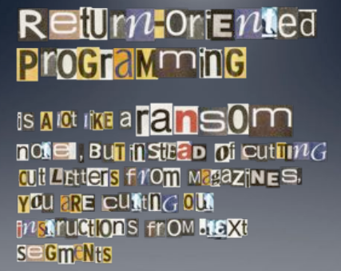

Slide 20
Defense
Hide the binary file(攻击者无法直接获取二进制文件)
No way to get any gadget
ASLR to randomize the code position(栈的位置随机化)
Short for "Address Space Layout Randomization"
Harder to find gadgets
Canary to protect the stack(金丝雀保护机制)
Try to detect stack overflow (e.g., overflow return address)

Slide 21
ASLR
Change the layout of memory space
Every time when a process is created
Question: how about create by fork?
User-level as well as kernel-level

Slide 22

Canary
Embed "canaries" in stack frames and verify their integrity prior to function return
Canary is just a random number
Check canary before return, alert if not equal
StackGuard implemented as a GCC patch
Program must be recompiled
Performance overhead: 8% for Apache
Stack
Return Addr
Canary

Slide 23
CFI: Control Flow Integrity

Slide 24
CFI: Control-Flow Integrity
Main idea: pre-determine control flow graph (CFG) of an application
Static analysis of source code
Static binary analysis ← CFI
Execution profiling
Explicit specification of security policy
Execution must follow the pre-determined control flow graph

Slide 25
CFI Motivation
Control flow
Anatomy of many software attacks
Notes:
Many software attacks consists in subverting the control-flow of a binary. Often the virus injects code of its own,. Then by a buffer overflow, it hijacks the program counter to execute the desired code, eventually reaching a point at which the system is compromised (e.g., a shell is executed).

Slide 26
CFI Idea
+
=
Executable
Control-Flow Graph
Self-checking program
Notes:
The idea of CFI is very simple: embed a simple security policy within the executable itself, in the form of a control-flow graph. The executable itself will monitor its execution, and any attempt to deviate from the prescribed CFG will result in an error. Thus, if a virus attempts to step outside the prescribed CFG, it will shut down the program.

Slide 27
Branch Types
Direct Branches
Direct call
Direct jump
Indirect Branches
Return
Indirect call
Indirect jump
In Apache and its libraries
Types | In Binary | Run-time
Direct call | 16.8% | 14.5%
Direct jump | 74.3% | 0.8%
Return | 6.3% | 16.3%
Indirect call | 2.1% | 0.2%
Indirect jump | 0.5% | 68.3%
has 1 target: 94.7%
<= 2 targets: 99.3%
>10 targets: 0.1%

Slide 28
CFI: Binary Instrumentation
Use binary rewriting to instrument code with runtime checks
Inserted checks ensure that the execution always stays within the statically determined CFG
Whenever an instruction transfers control, destination must be valid according to the CFG
Goal: Secure even if the attacker has complete control over the thread's address space

Slide 29
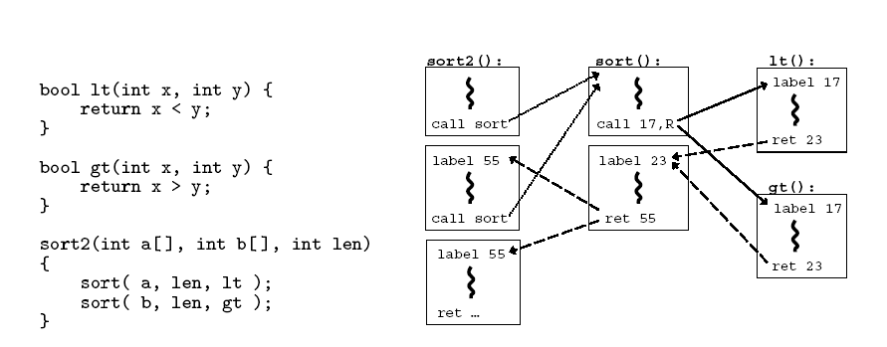
CFG Example

Slide 30
CFI: Control Flow Enforcement
For each control transfer, determine statically its possible destination(s)
Insert a unique bit pattern at every destination
Two destinations are equivalent if CFG contains edges to each from the same source
This is imprecise (why?)
Use same bit pattern for equivalent destinations

Slide 31
CFI: Control Flow Enforcement
Insert binary code that at runtime will check whether the bit pattern of the target instruction matches the pattern of possible destinations

Slide 32
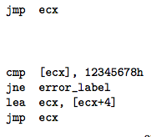
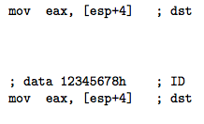
CFI: Example of Instrumentation
Original
Patched

Slide 33
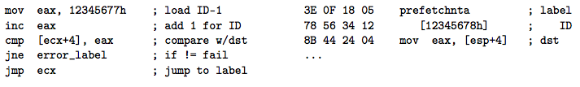
CFI: Example of Instrumentation
Prefetchnta: prefetch memory to cache. Become a nop if not available.

Slide 34
CFI: Preventing Circumvention
Unique IDs
Bit patterns chosen as destination IDs must not appear anywhere else in the code memory except ID checks
Non-writable code
Program should not modify code memory at runtime
What about run-time code generation and self-modification?
Non-executable data
Program should not execute data as if it were code
Enforcement: hardware support + prohibit system calls that change protection state + verification at load-time

Slide 35
Improving CFI Precision
Suppose a call from A goes to C, and a call from B goes to either C, or D (when can this happen?)
CFI will use the same tag for C and D, but this allows an "invalid" call from A to D
Possible solution: duplicate code or inline
Possible solution: multiple tags

Slide 36
Improving CFI Precision
Function F is called first from A, then from B; what's a valid destination for its return?
CFI will use the same tag for both call sites, but this allows F to return to B after being called from A
Solution: shadow call stack
Maintain another stack, just for return address
Intel CET to the rescue (not available yet)

Slide 37
CFI: Security Guarantees
Effective against attacks based on illegitimate control-flow transfer
Stack-based buffer overflow, return-to-libc exploits, pointer subterfuge
Does not protect against attacks that do not violate the program's original CFG
Incorrect arguments to system calls
Substitution of file names
Other data-only attacks

Slide 38
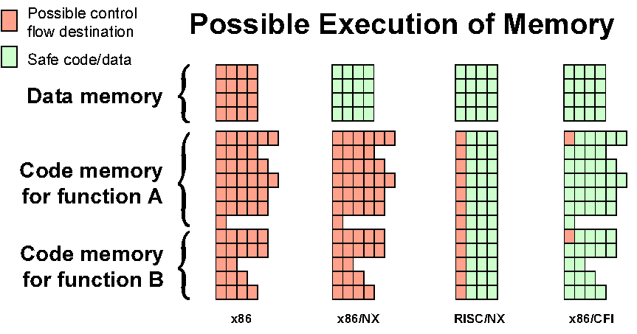
Possible Execution of Memory
[Erlingsson]

Slide 39
Blind ROP

Slide 40
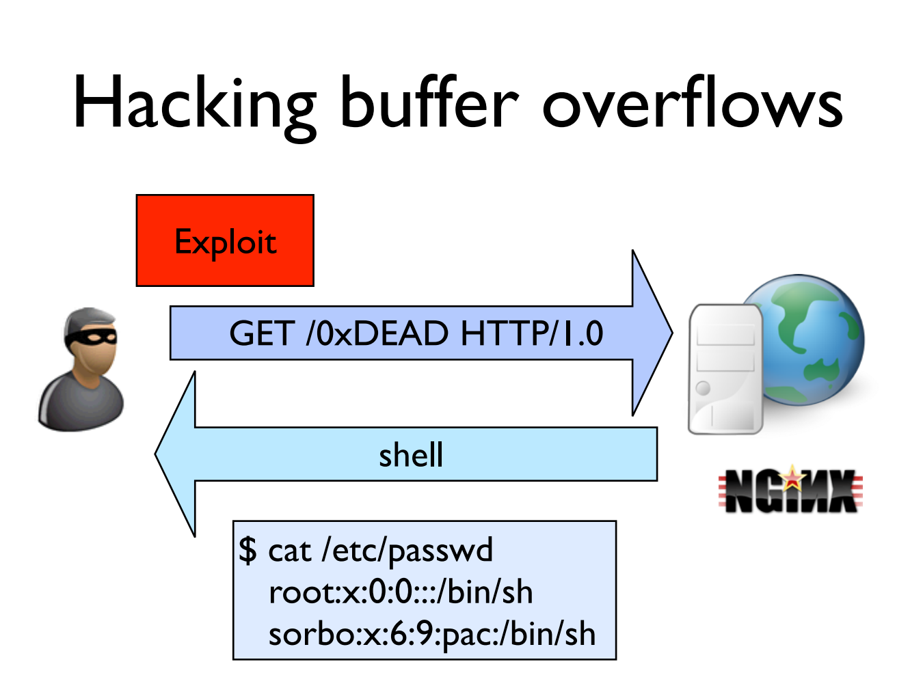

Slide 41
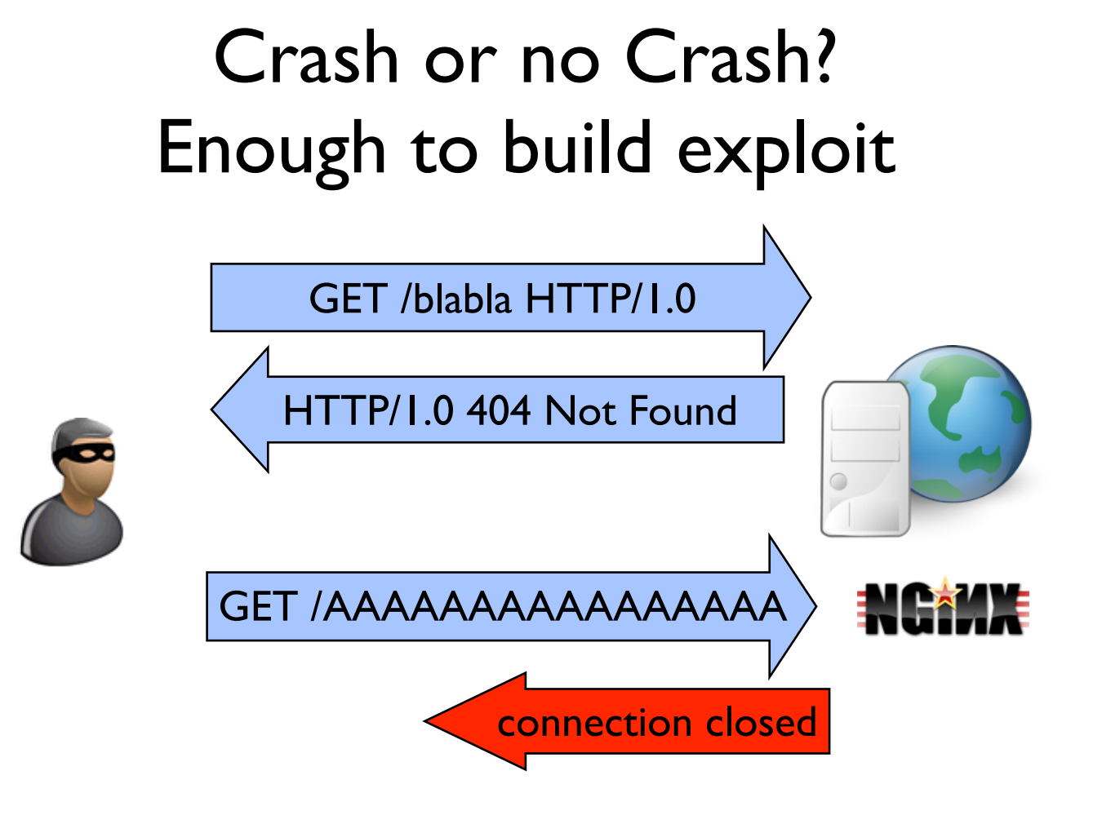

Slide 42
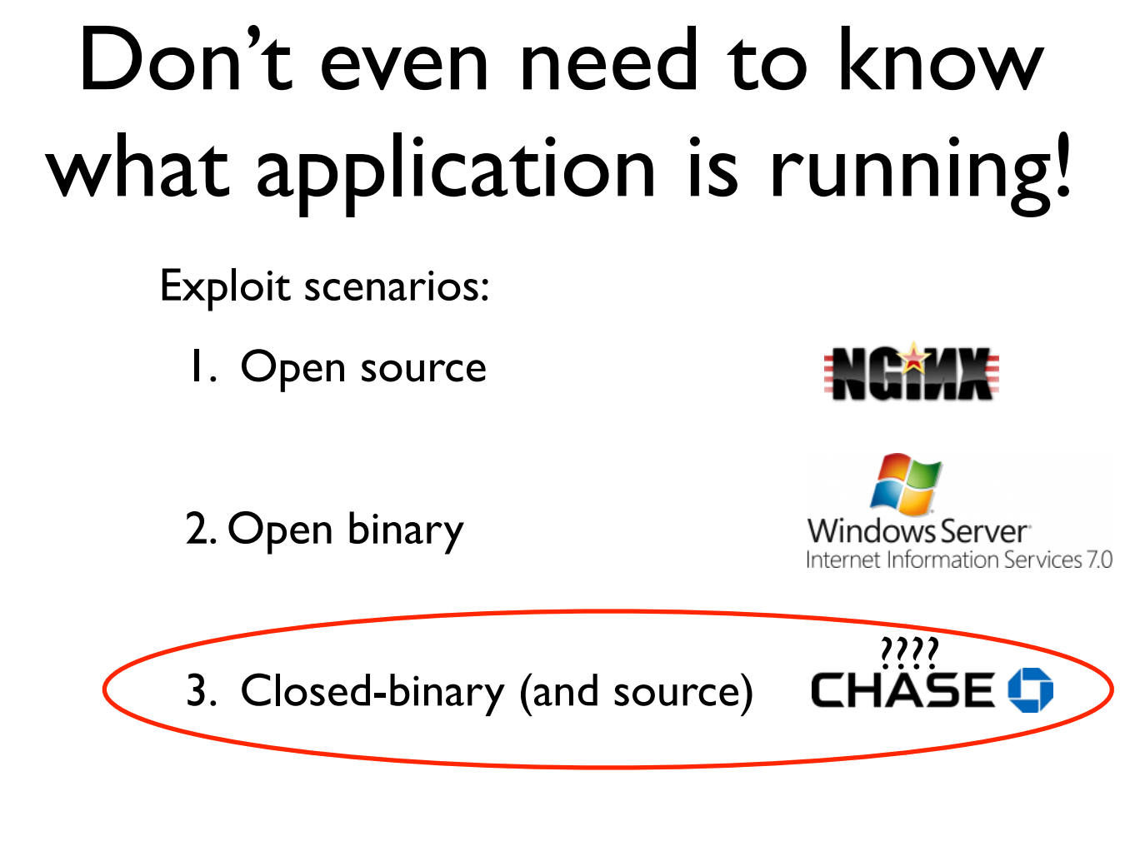

Slide 43
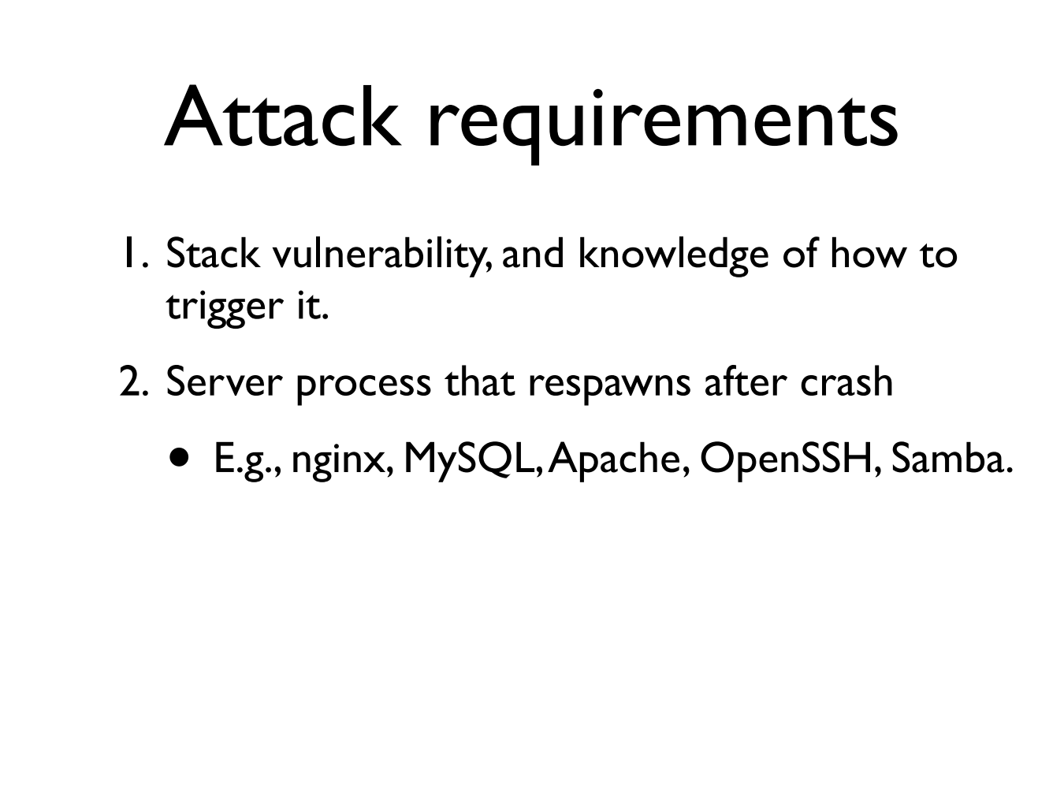
respawn：重启
通过多次猜测最终却能得到真正的ret addr的原因：
连接client的是一个从主process中fork出来的一个新的child process，而这些child process是与parent共享相同的ret address的，所以只要parent没有崩溃，
child们都会具有相同ret addr。因此可以通过多次强制crash+respawn来使得
ASLR失效。

Slide 44
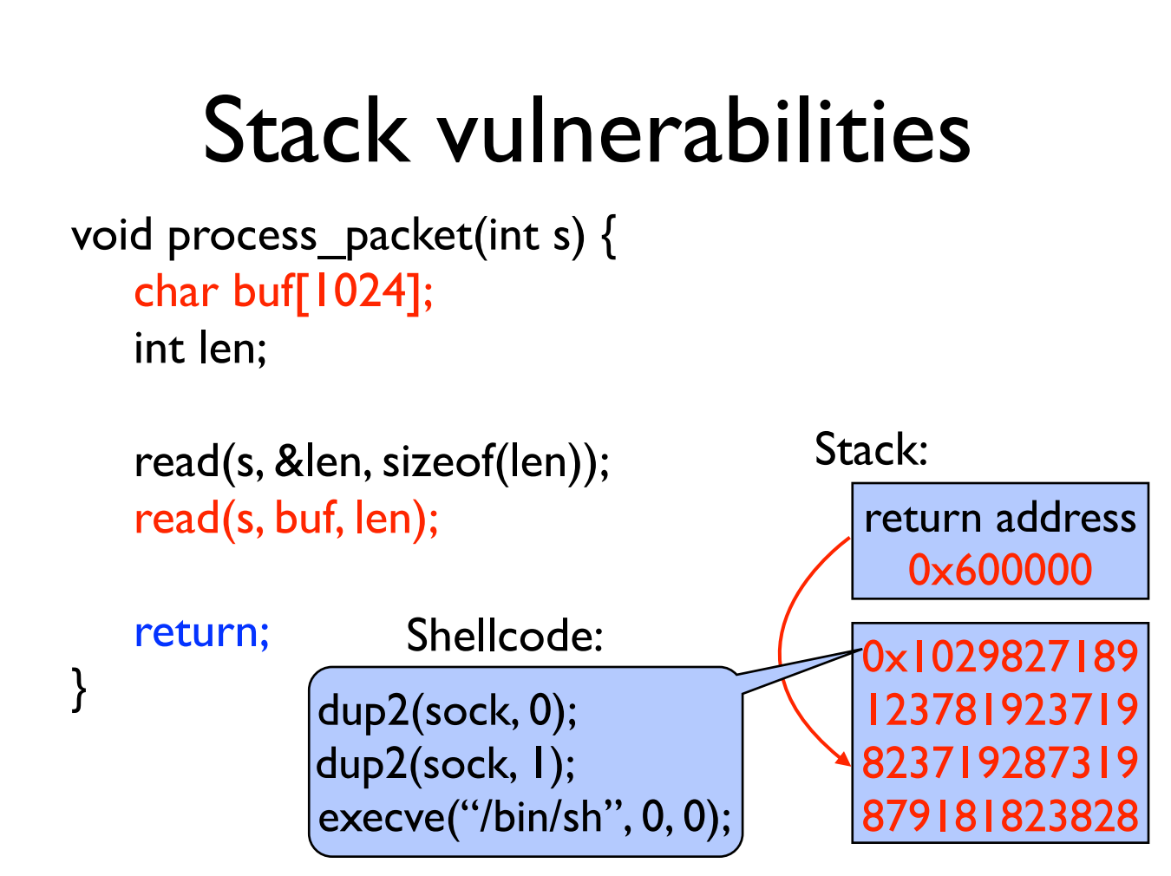

Slide 45
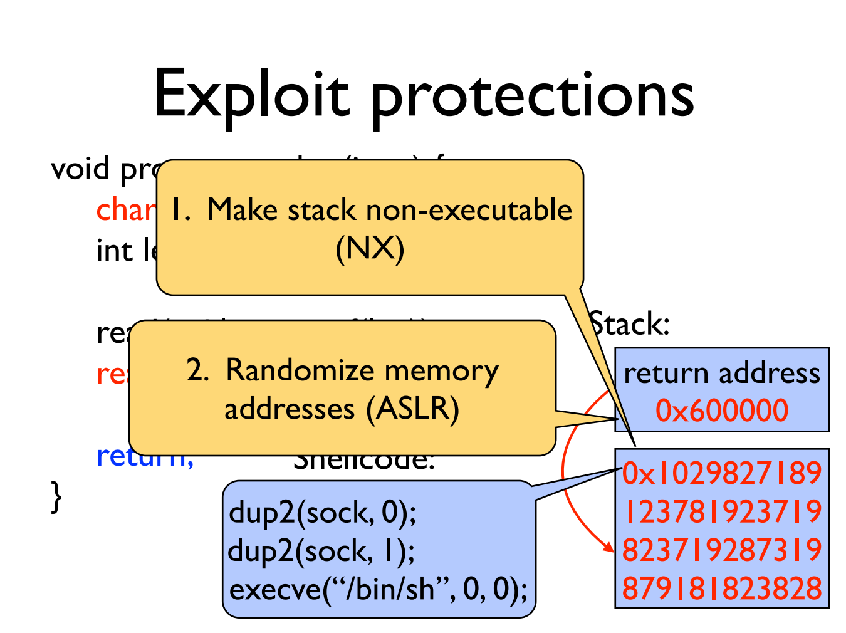

Slide 46
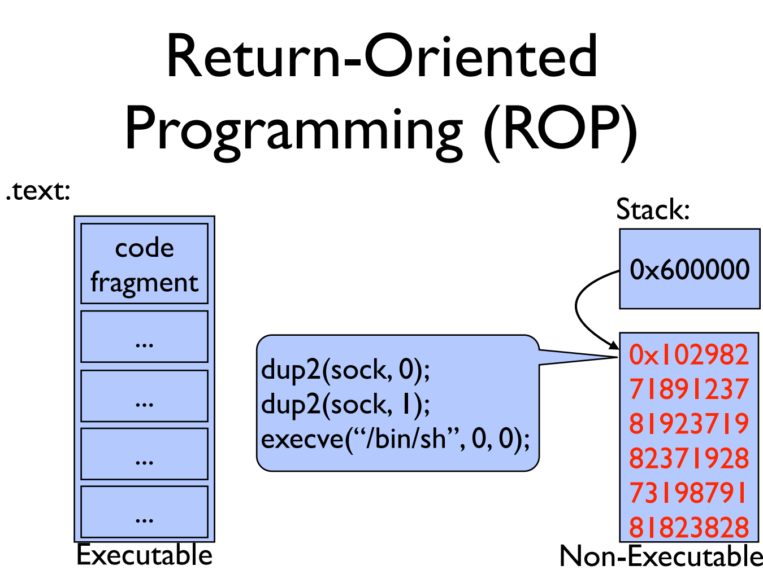

Slide 47
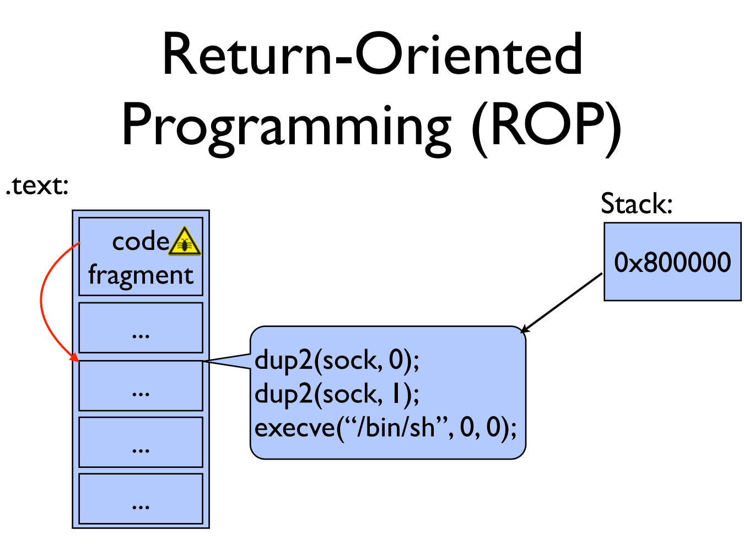
两次dup2目的是使得server的stdin和stdout与用户直接连接。

Slide 48
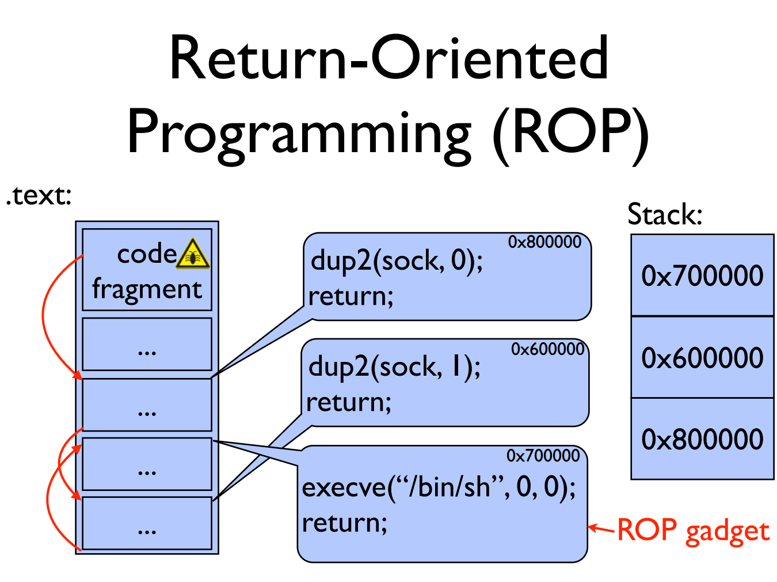

Slide 49
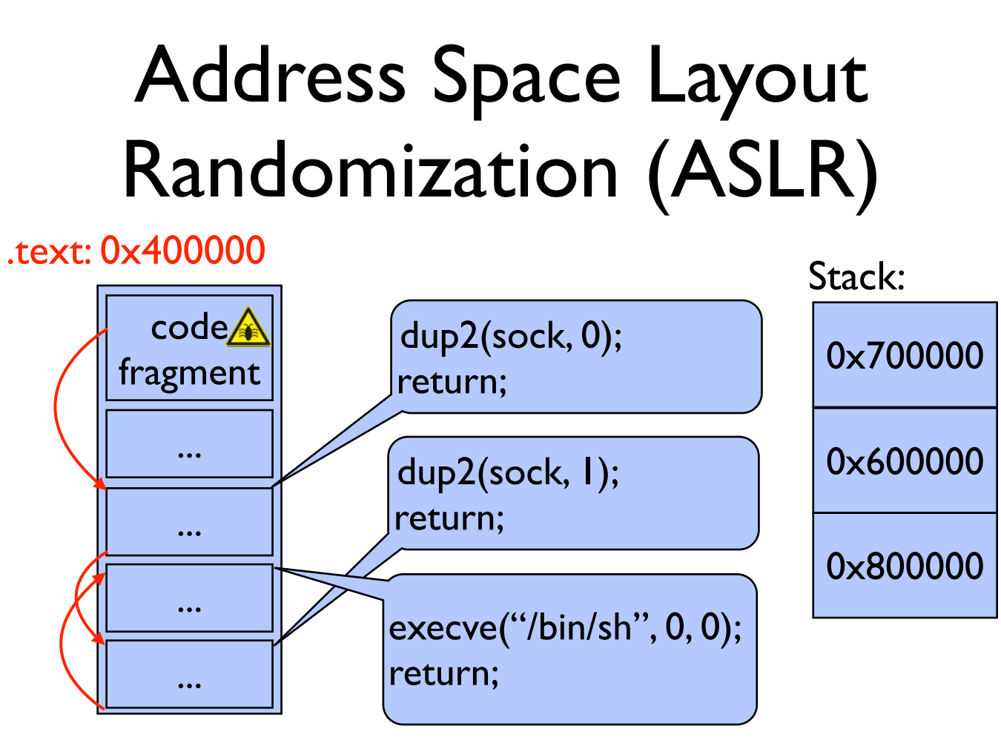

Slide 50
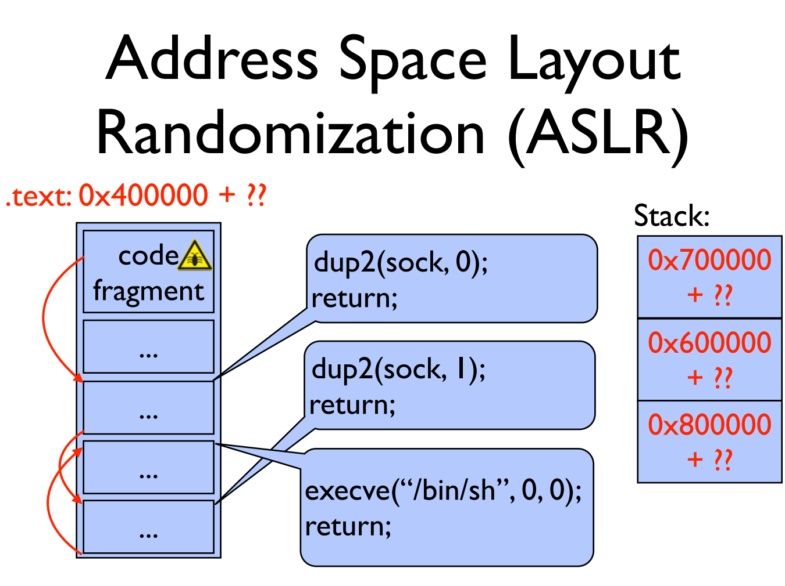

Slide 51
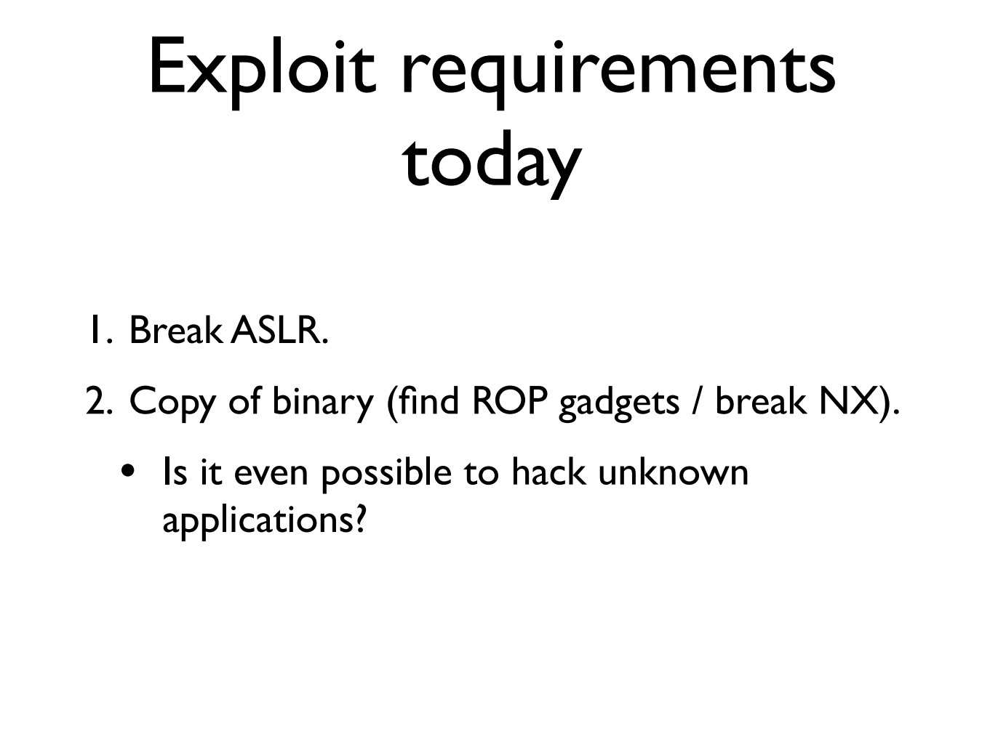

Slide 52
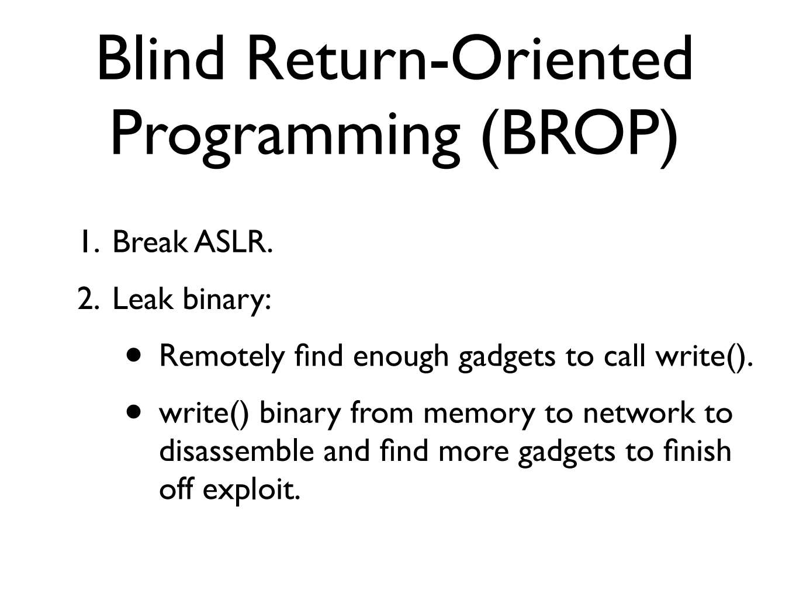

Slide 53
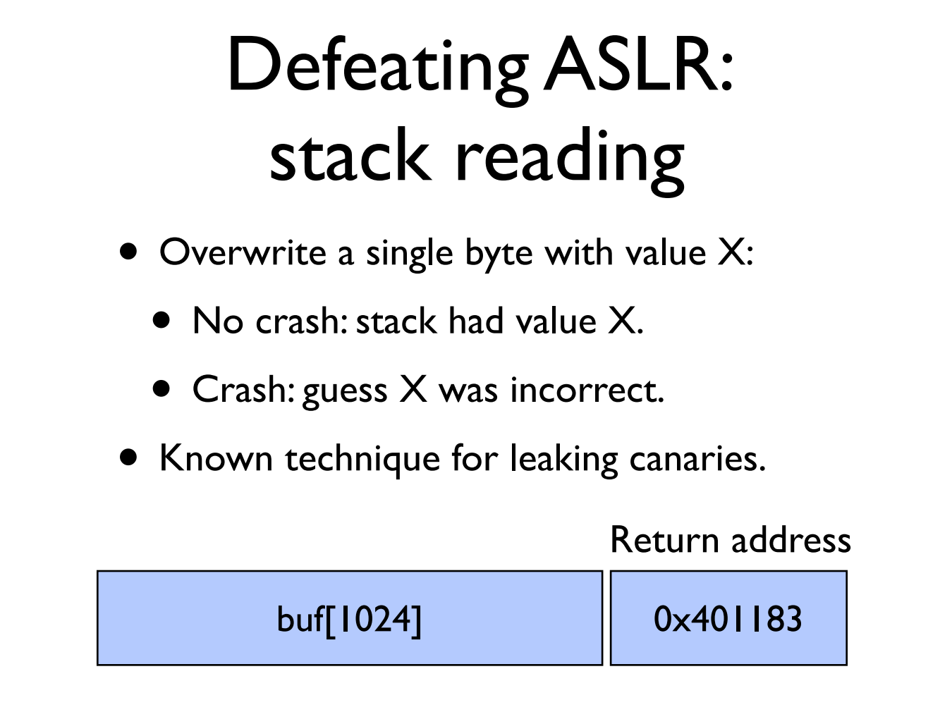

Slide 54
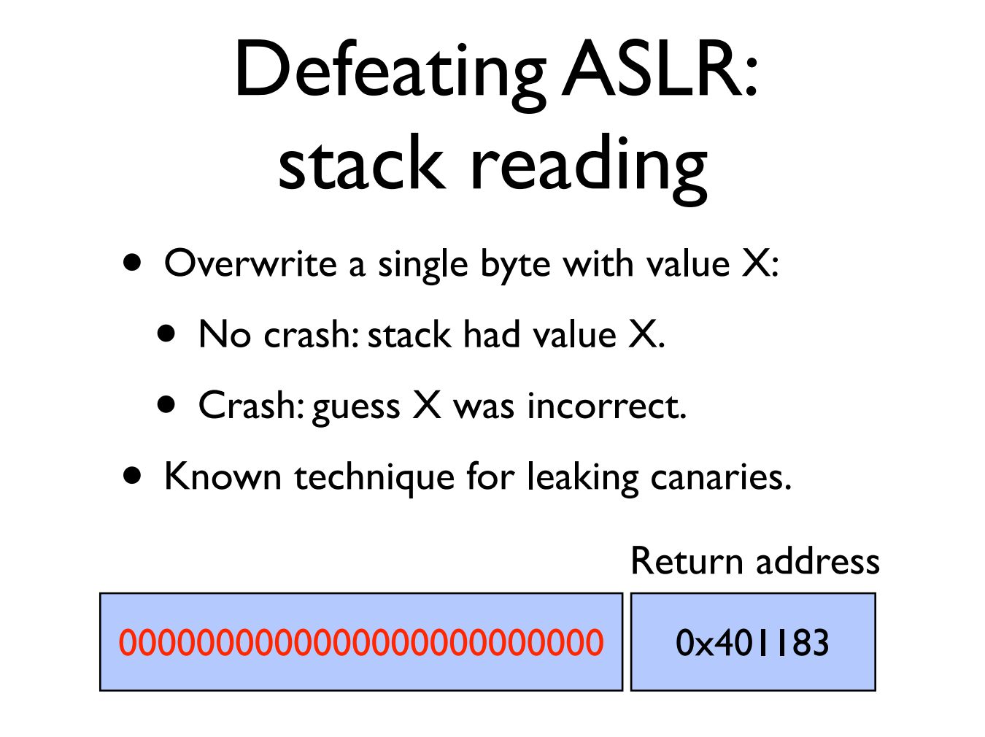

Slide 55
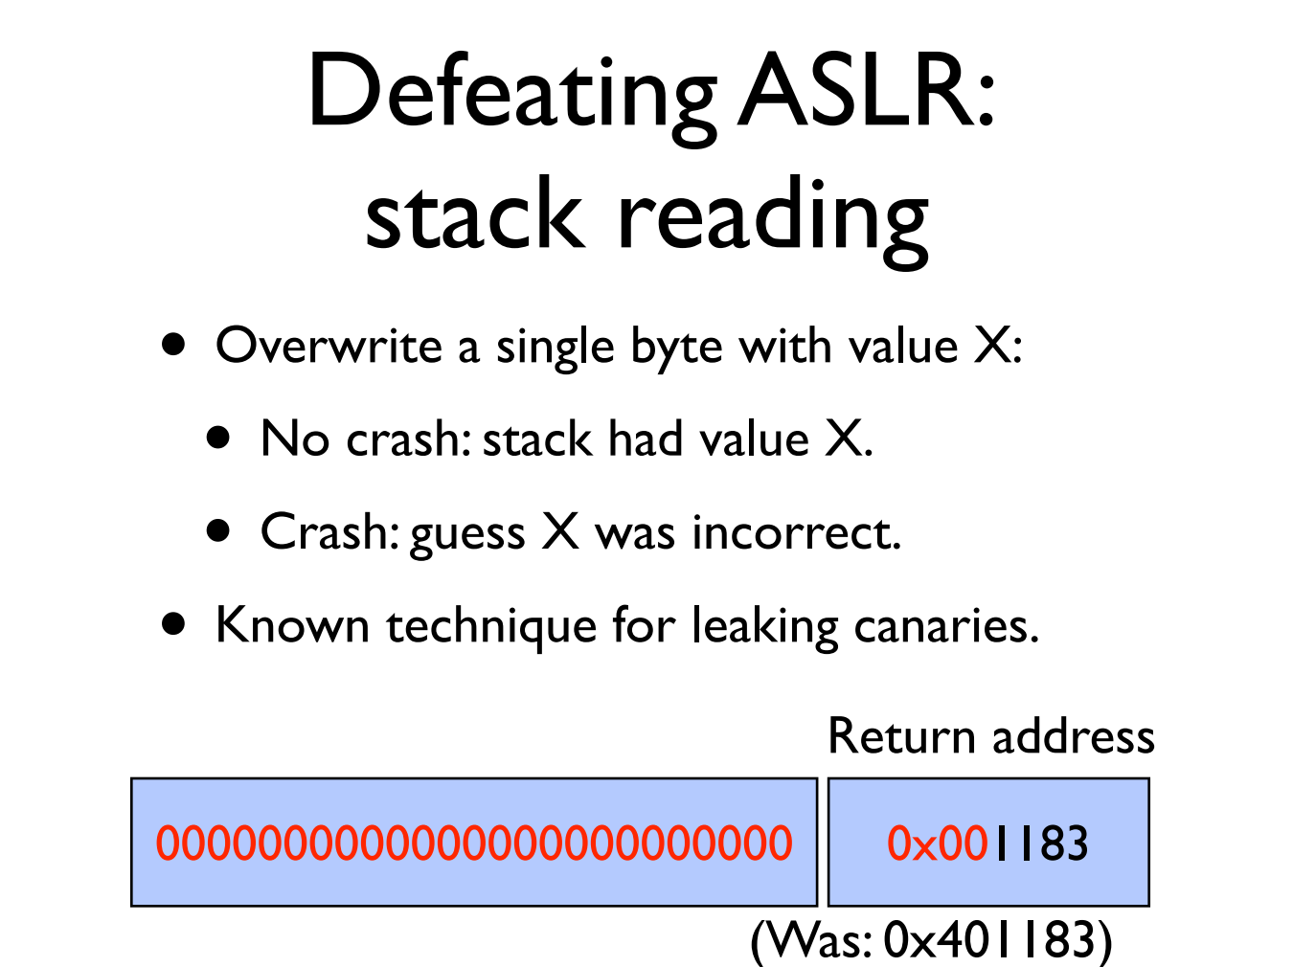

Slide 56


Slide 57


Slide 58
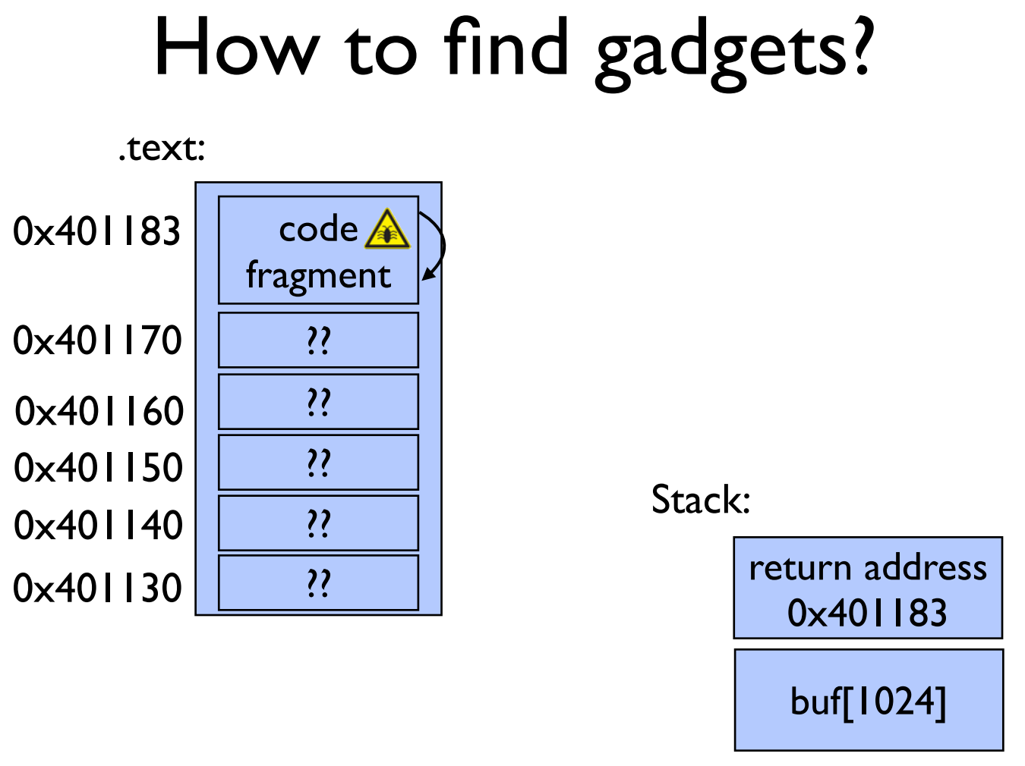

Slide 59
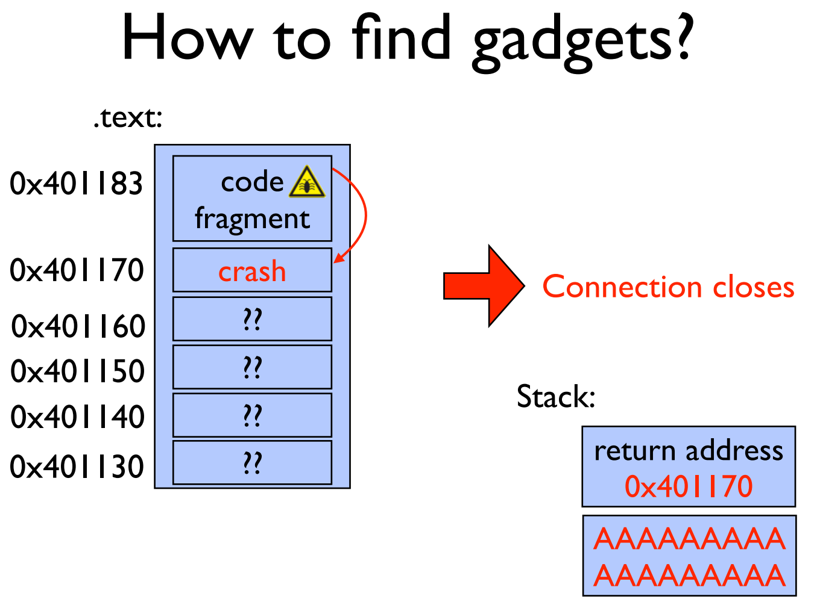

Slide 60


Slide 61
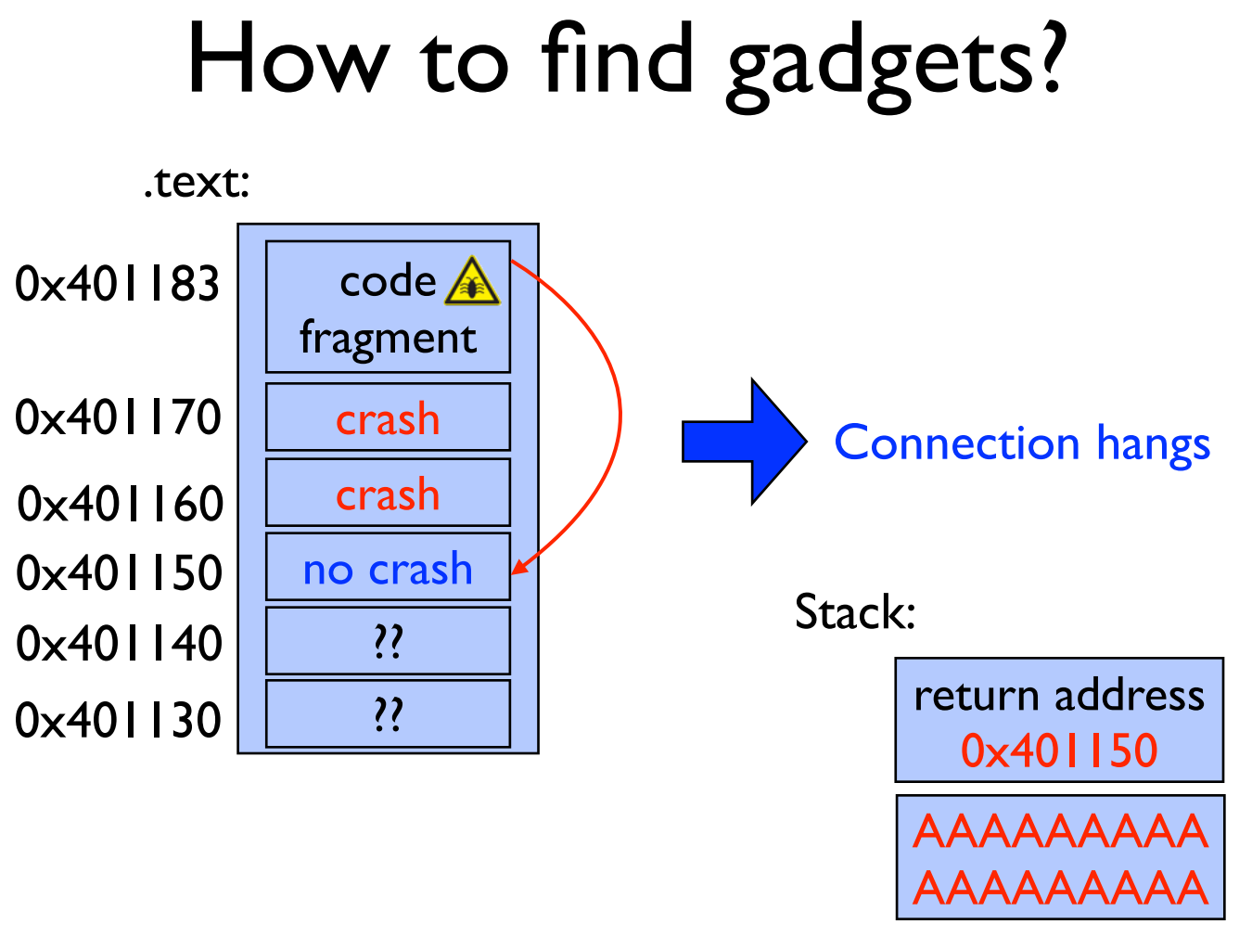

Slide 62
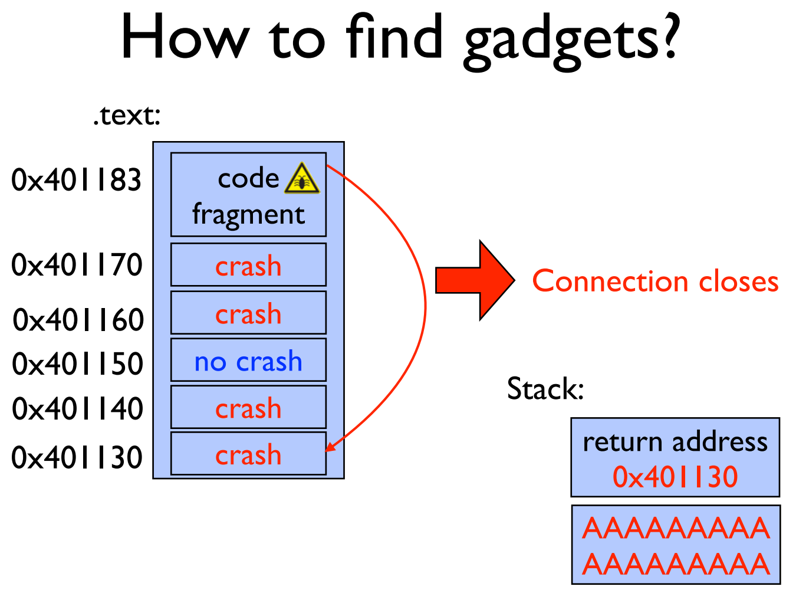

Slide 63
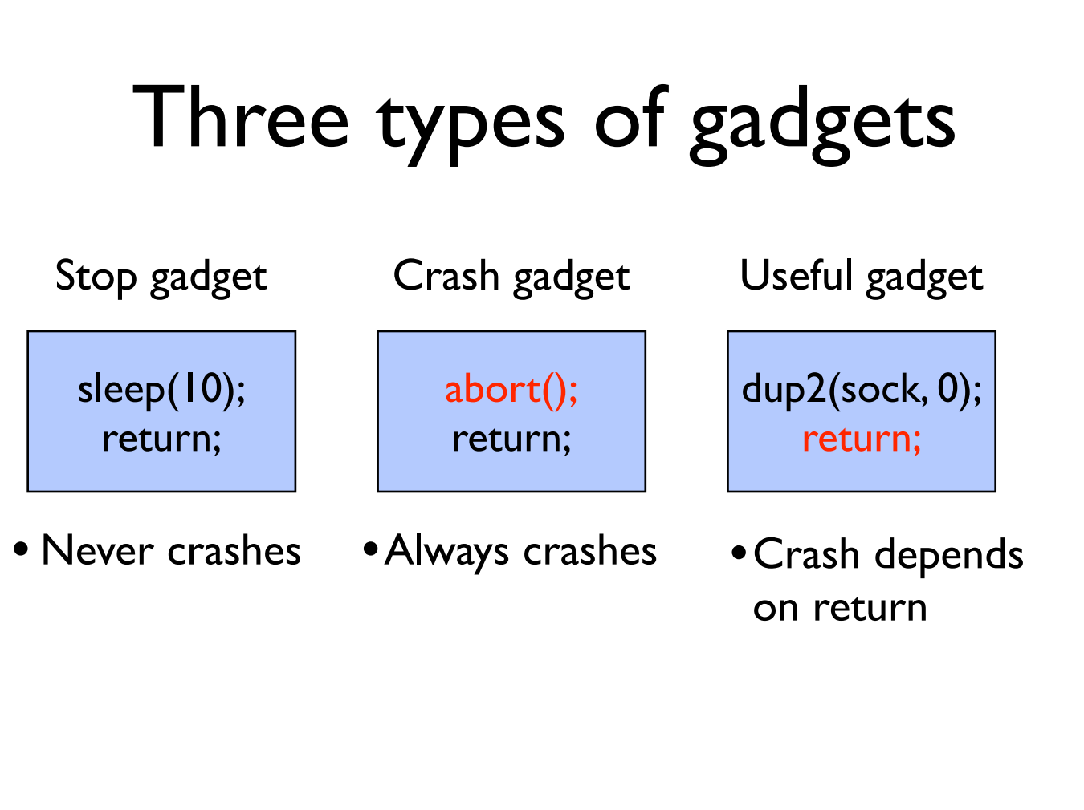
Stop gadget:指的是ret到一个代码段之后没有crash
crash gadget：指的是ret到一个代码段之后发生了crash，等价于执行了一个abort().
useful gadget:指的是执行了一些代码，并且最后跟着一个ret的gadget。判断方式是：修改这个gadgetret的下一个地址，若有时候hang有时候crash，那么就是useful的。

Slide 64
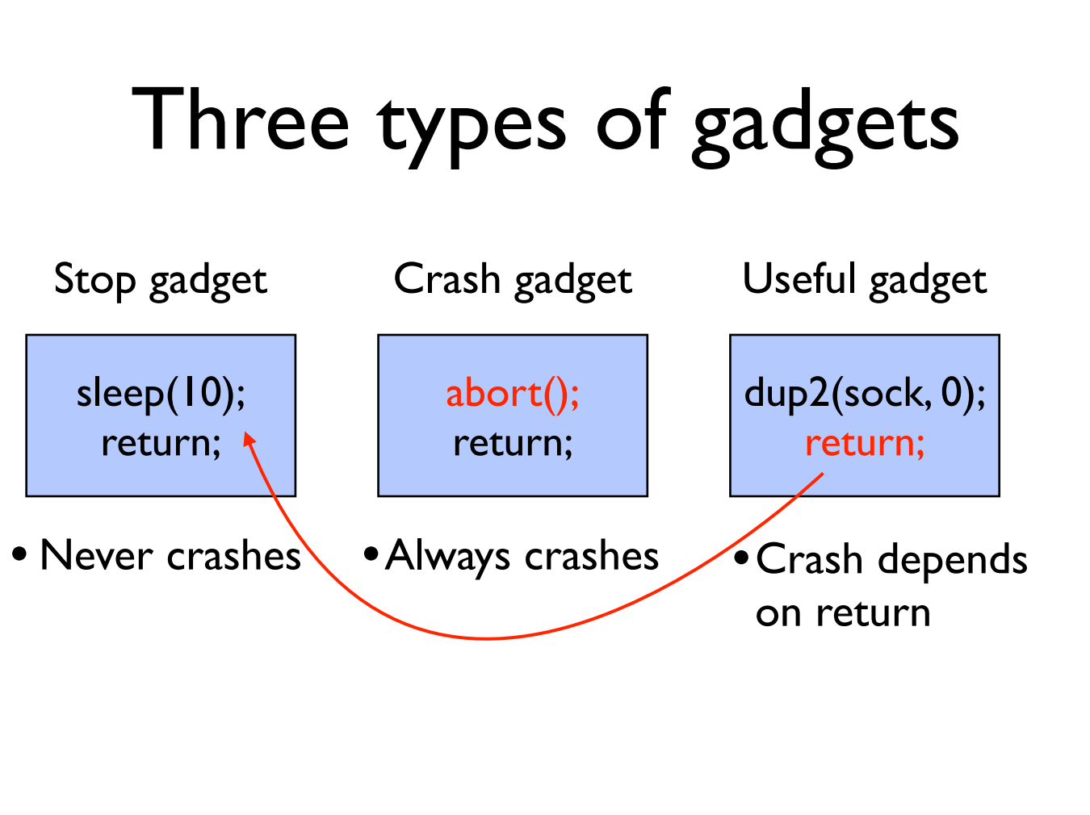

Slide 65
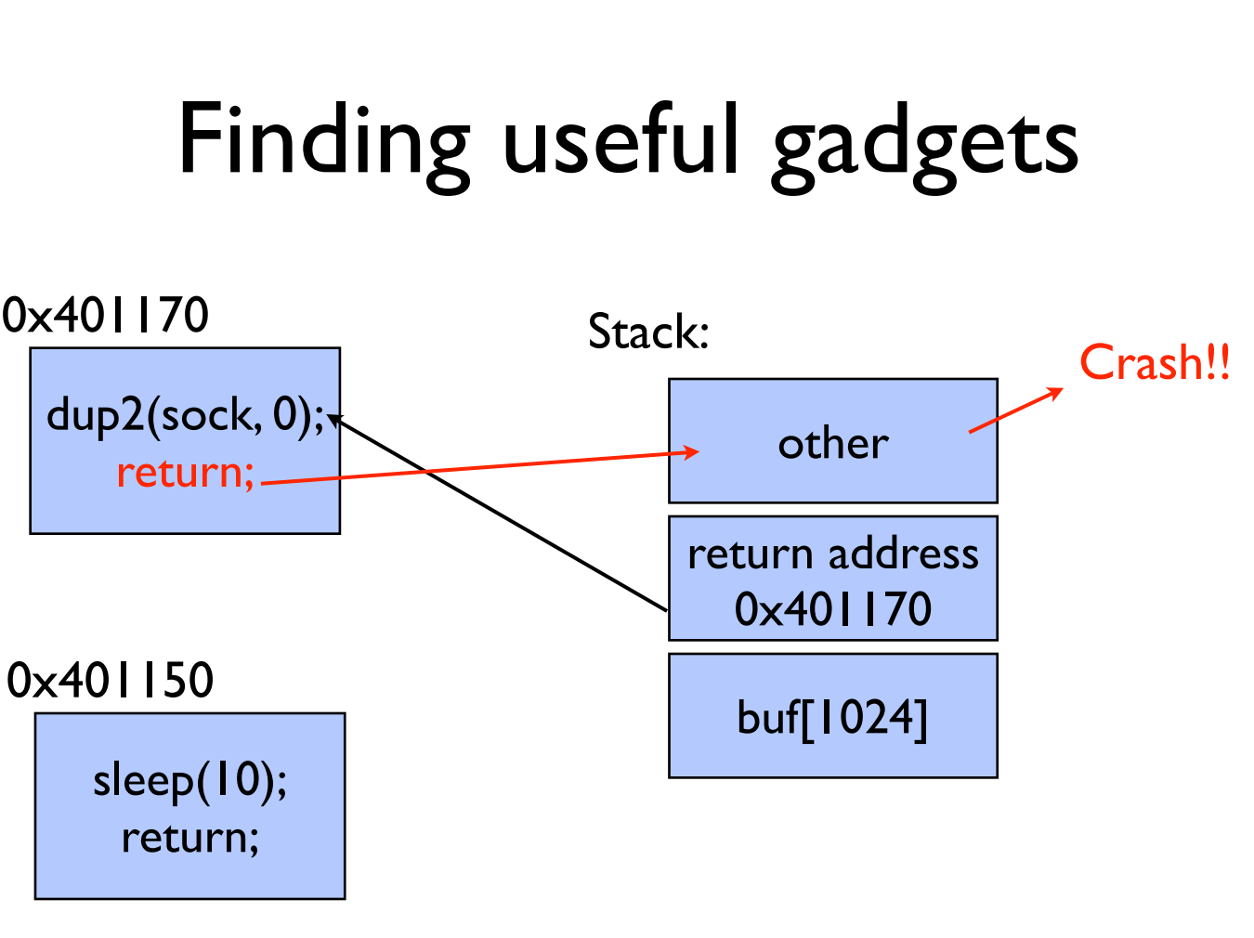

Slide 66
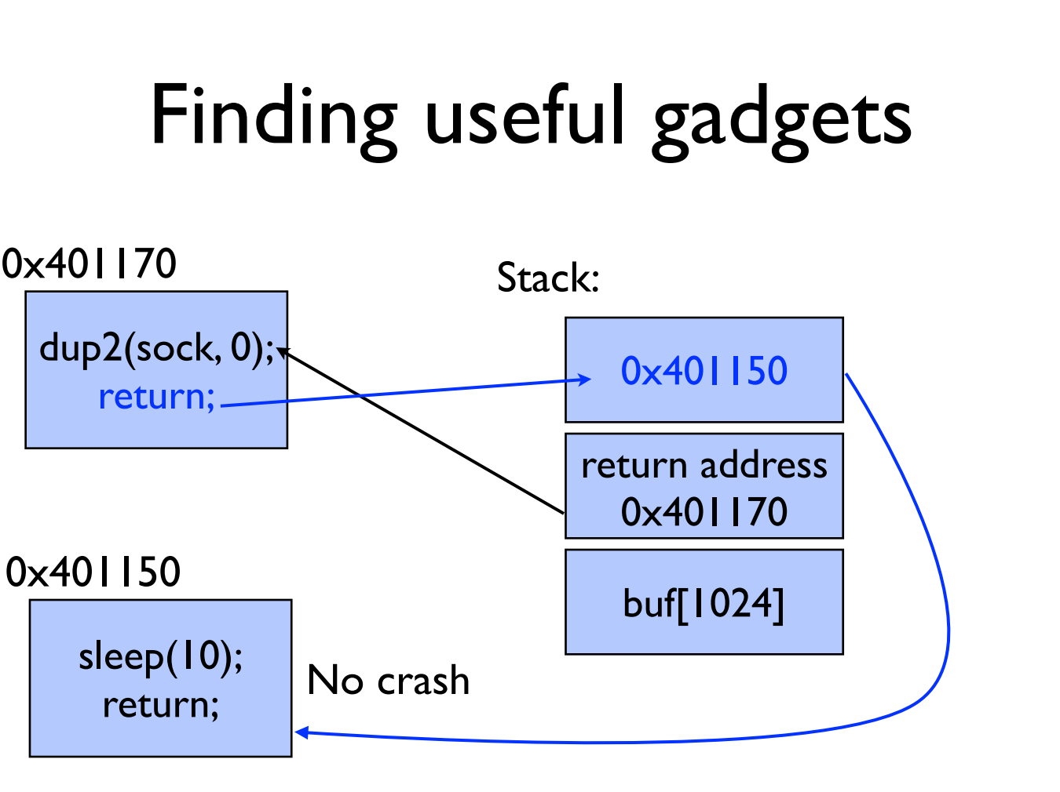

Slide 67
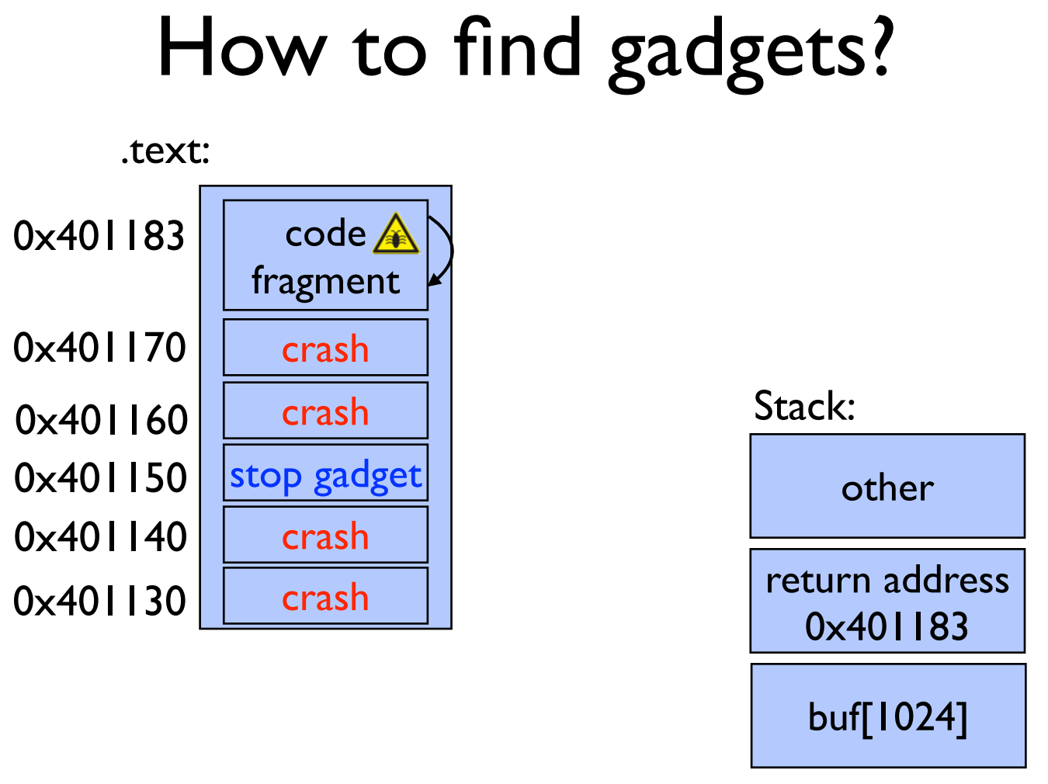

Slide 68
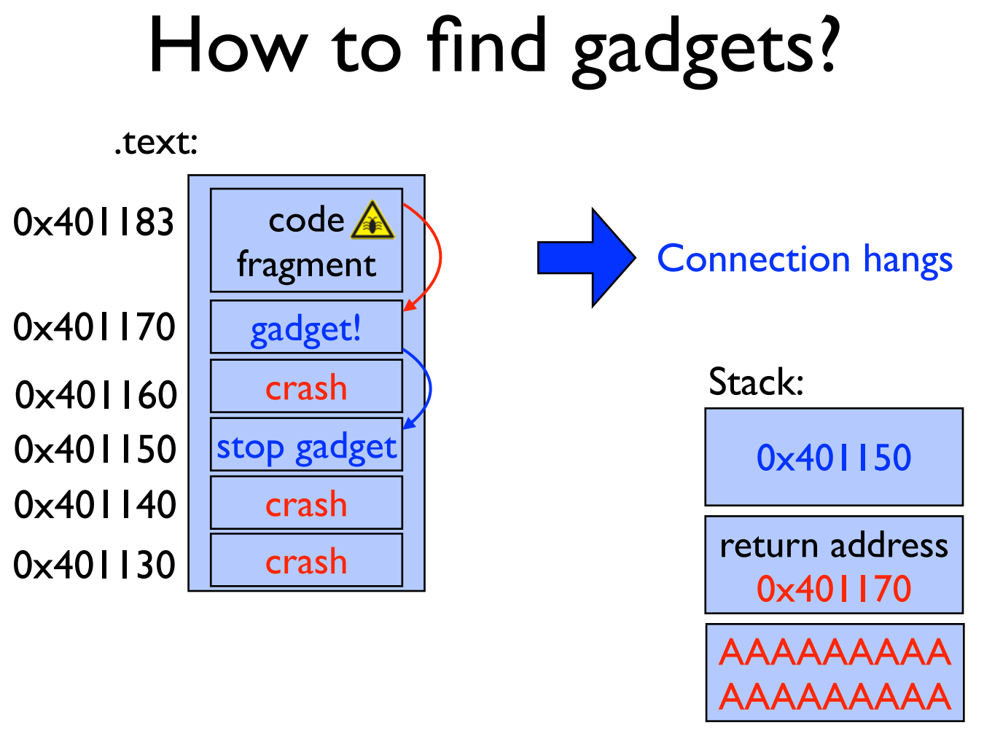
因为跳到401170之后又跳到别的地方，说明有一个ret

Slide 69
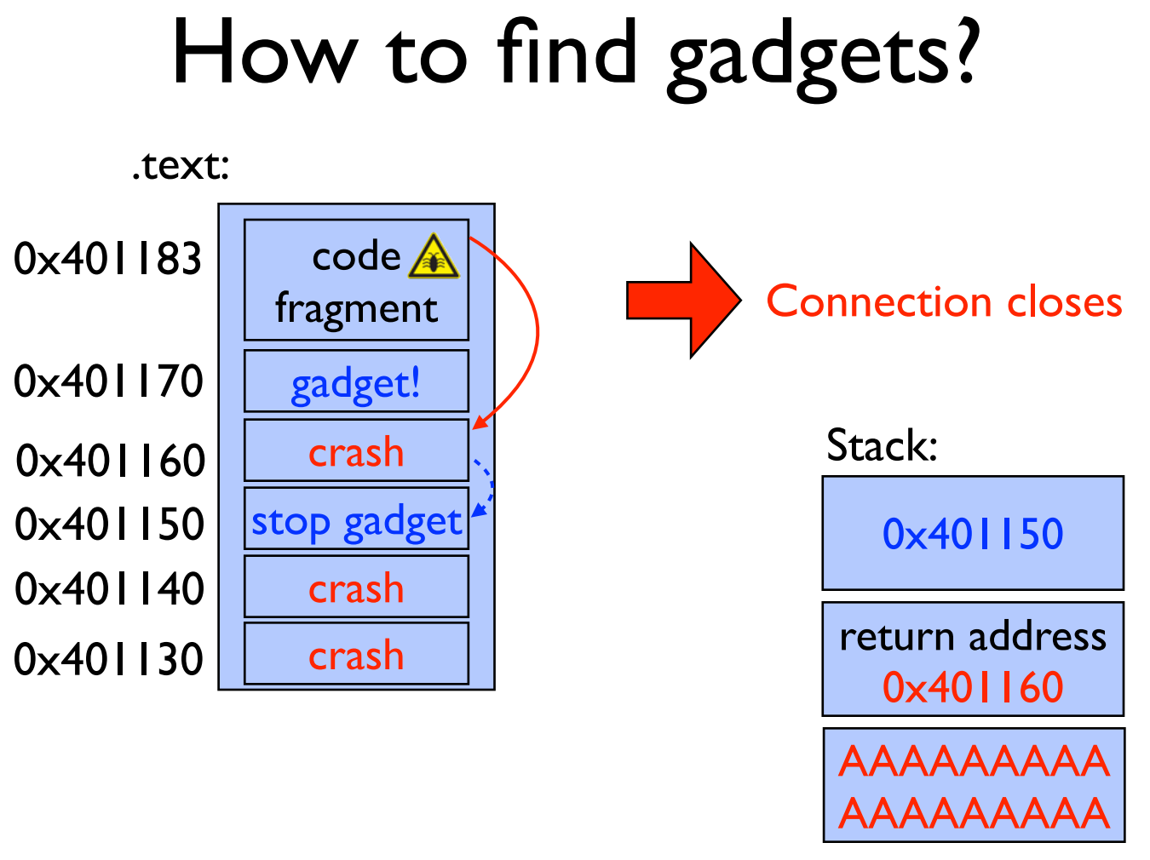

Slide 70
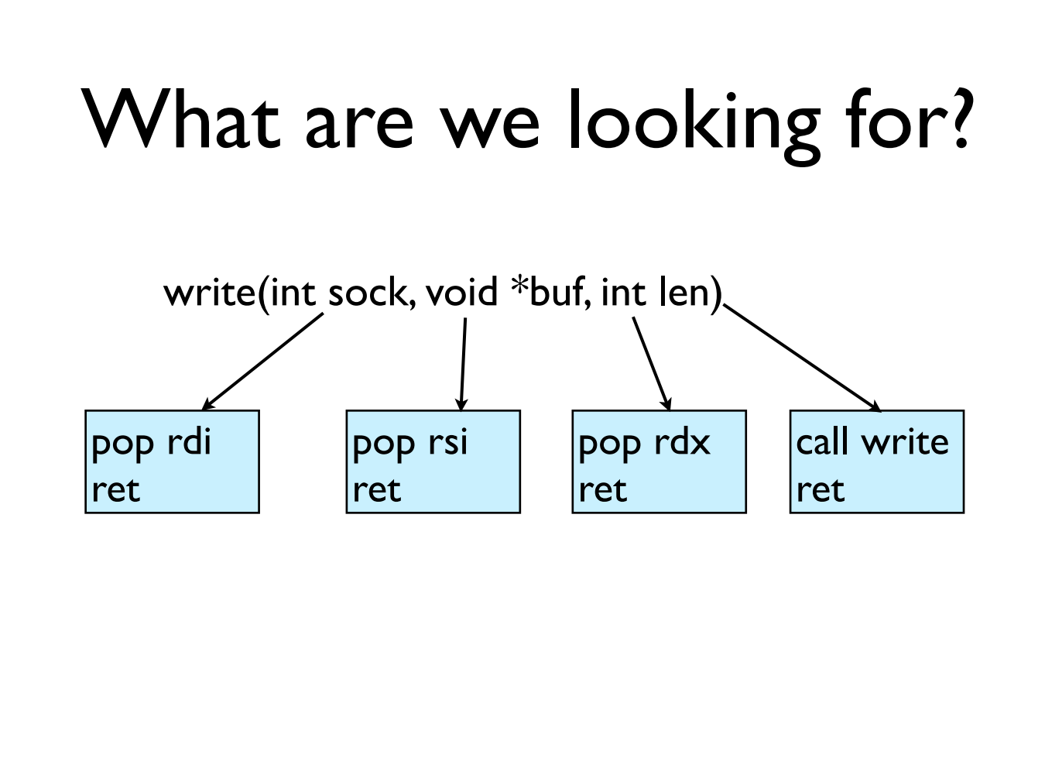

Slide 71
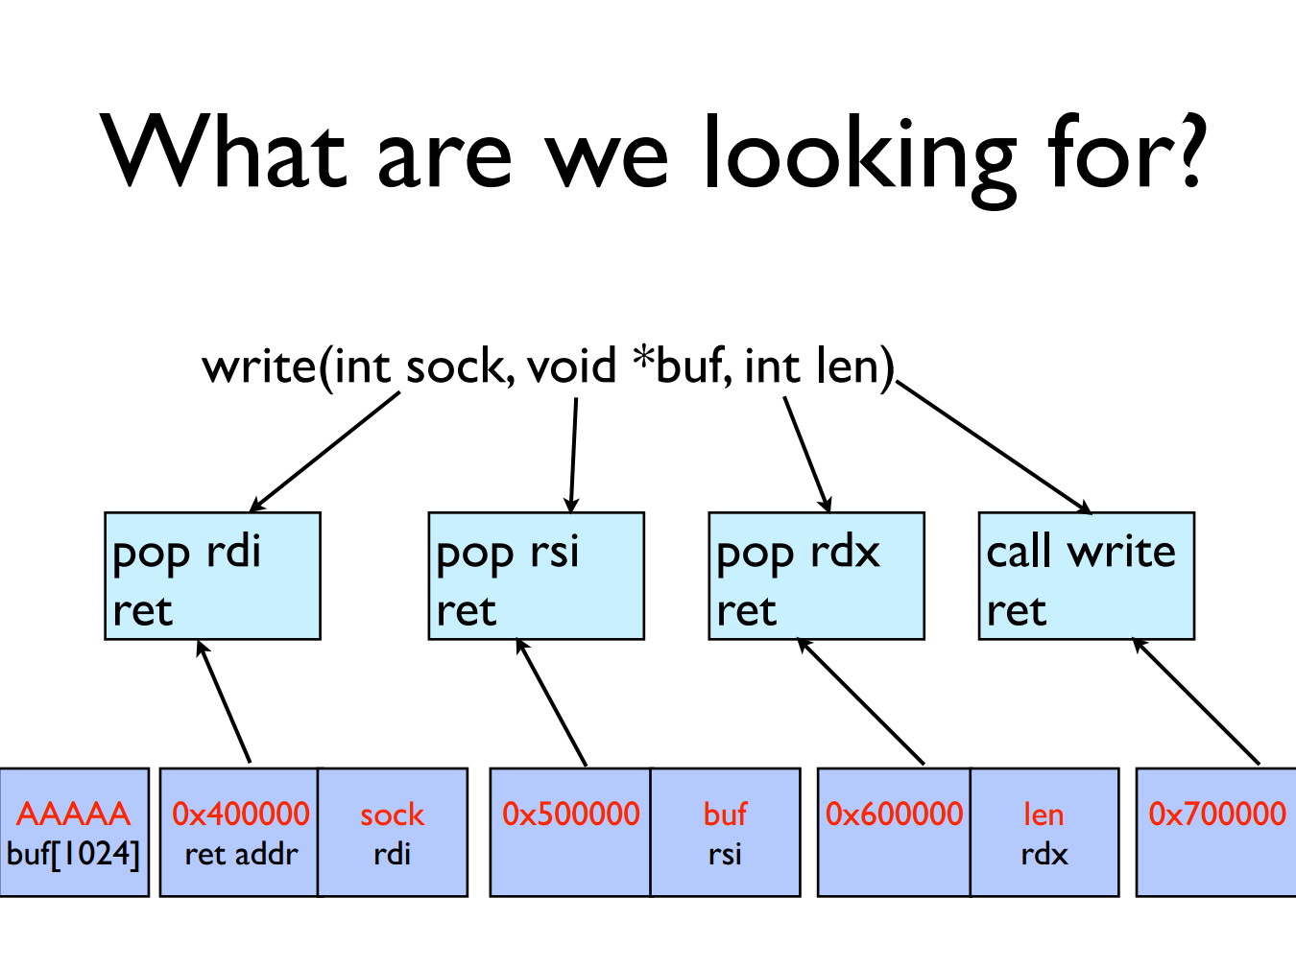

Slide 72
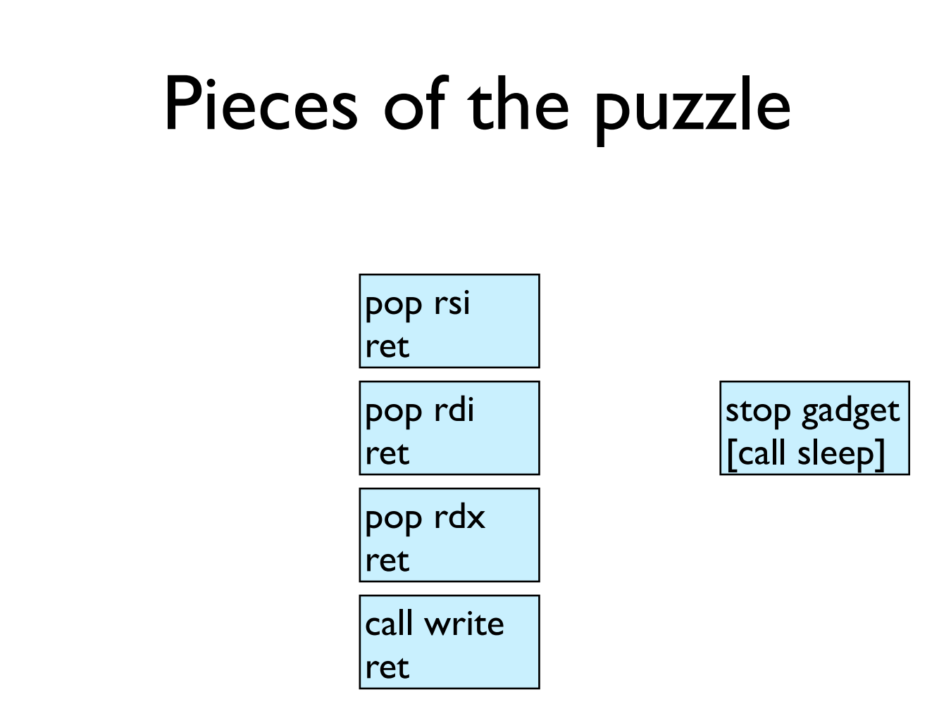

Slide 73
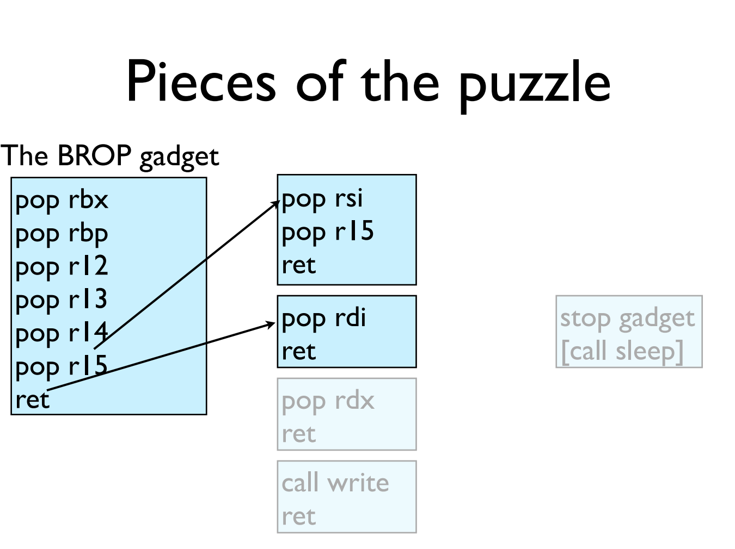
restore callee saved regs
回想ICS lab3，可以通过剪切一个指令的表示码的方式来执行另外一条指令。

Slide 74
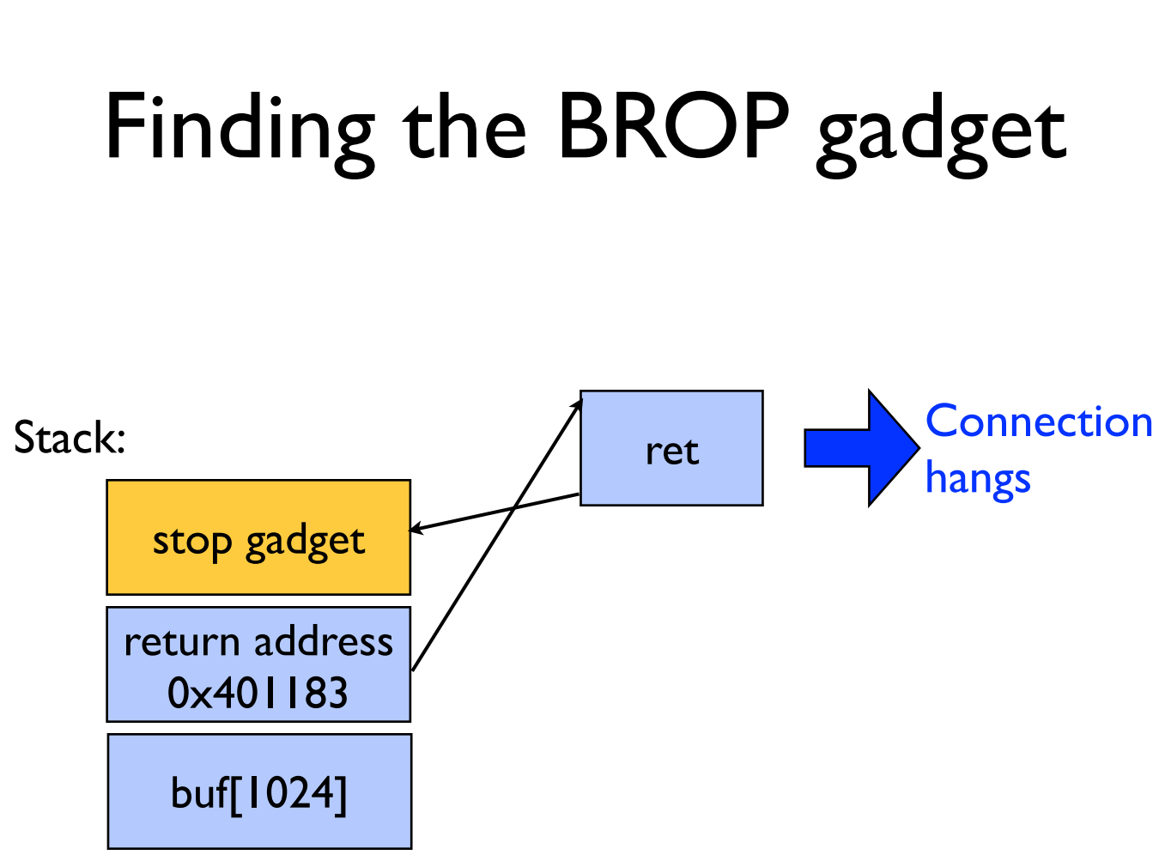

Slide 75
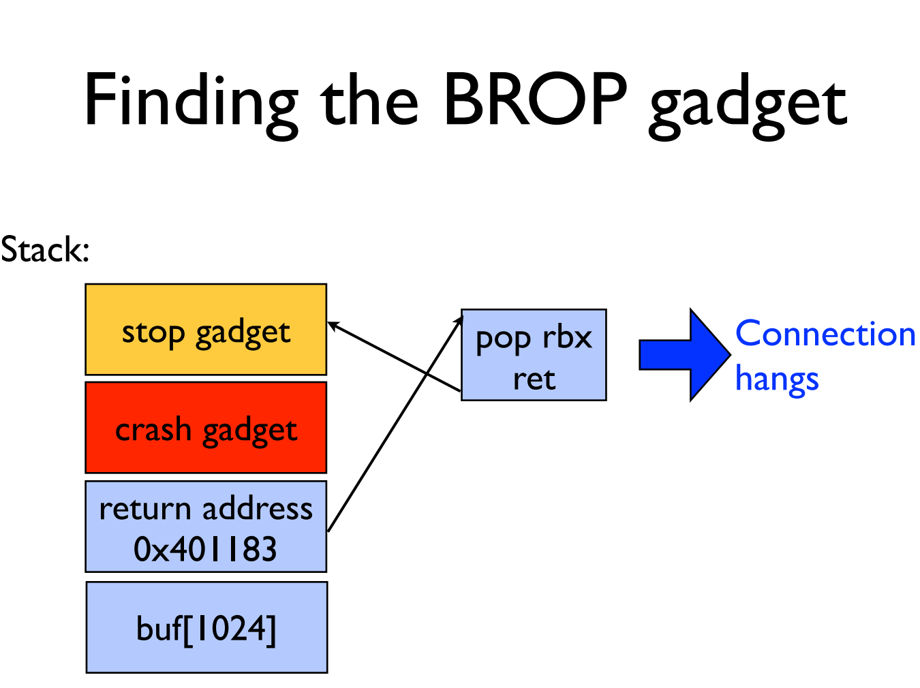
在ret之前加上一个crash gadget，那么如果ret之后没有进入crash，说明发生了一次pop+ret。

Slide 76
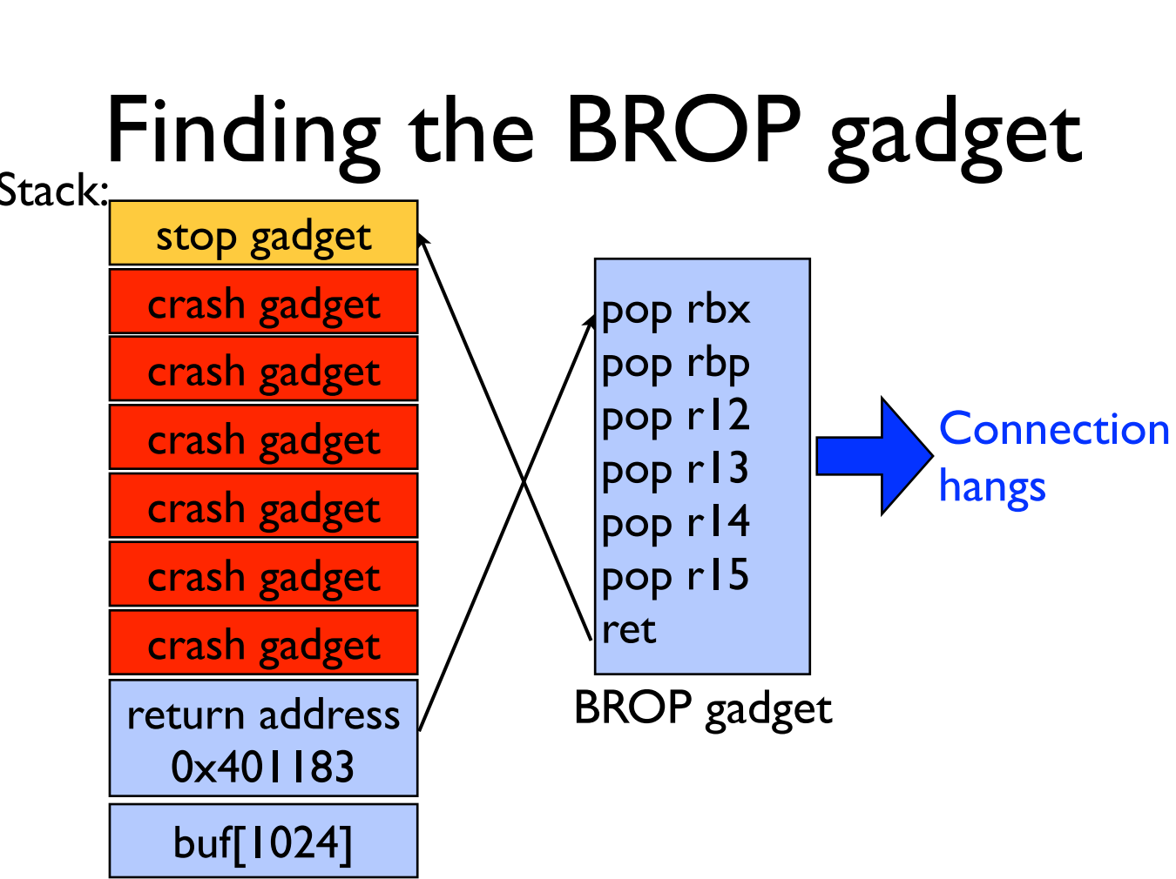

Slide 77
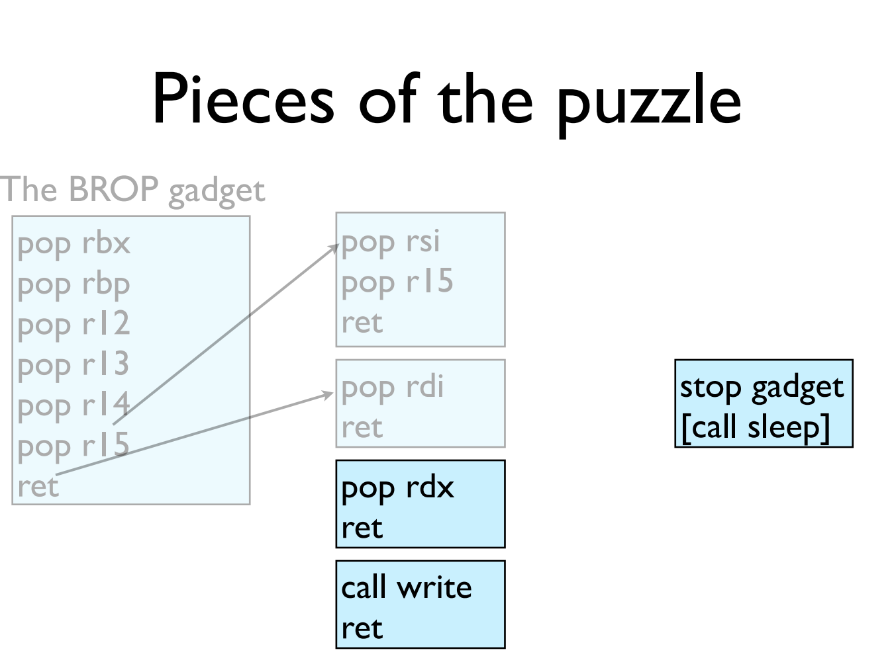

Slide 78
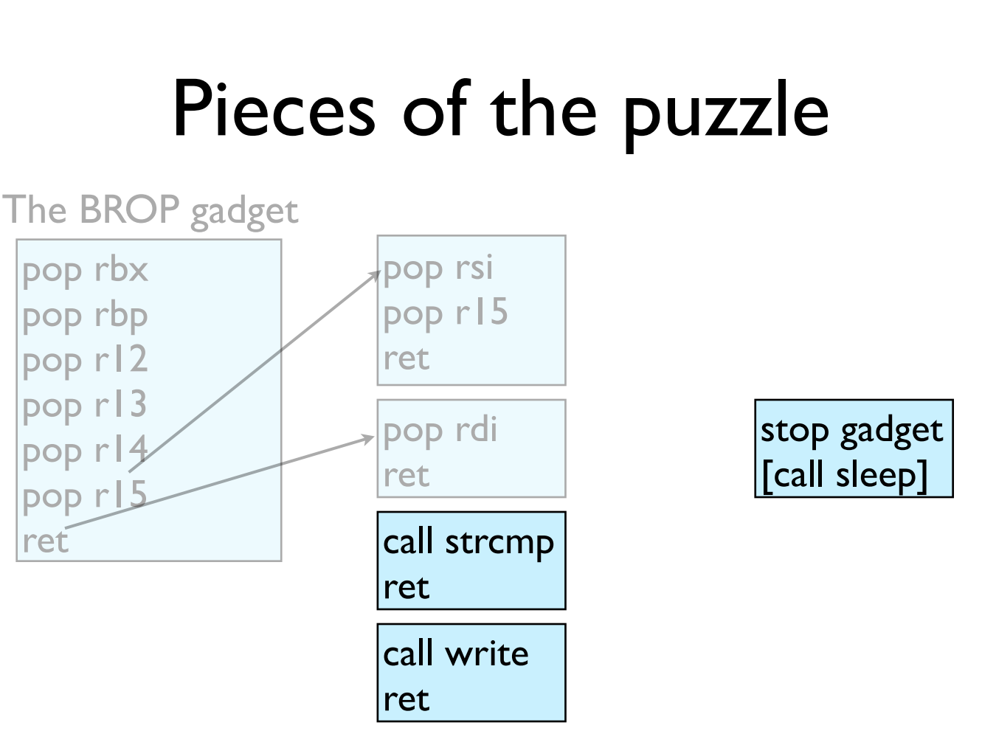

Slide 79
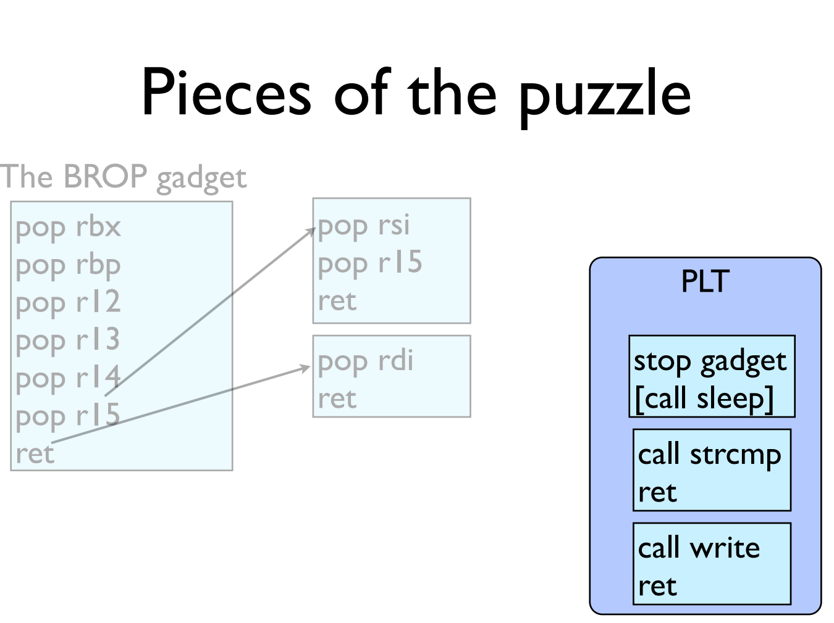

Slide 80
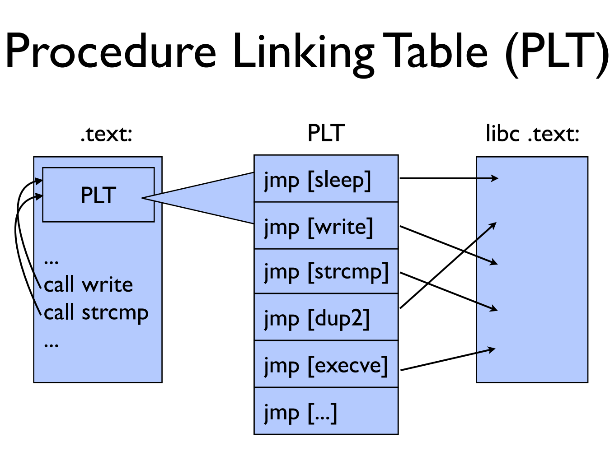

Slide 81
GOT & PLT
Jump to the address that this entry of the GOT contains:
First time: call to dynamic linker and write the function address to GOT
Not first time: the GOT already contains the address that points to printf.
PLT
printf() call
Dynamic linker
libc
GOT

Slide 82
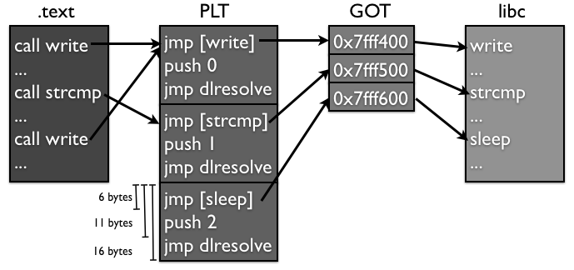
Notes:
另外，大部分的PLT项都不会因为传进来的参数的原因crash，因为它们很多都是系统调用，都会对参数进行检查，如果有错误会返回EFAULT而已，并不会造成进程crash。所以攻击者可以通过下面这个方法找到PLT：如果攻击者发现好多条连续的16个字节对齐的地址都不会造成进程crash，而且这些地址加6得到的地址也不会造成进程crash，那么很有可能这就是某个PLT对应的项了。

Slide 83
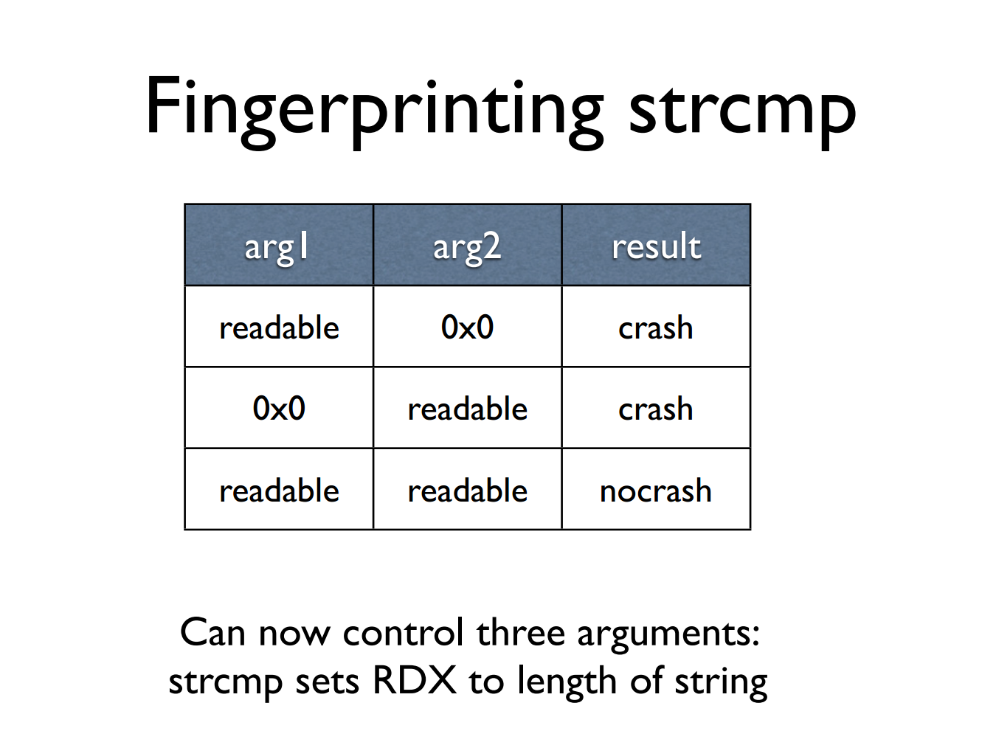

Slide 84

Notes:
1. 同时调用好几次write，把它们串起来，然后传入不同的文件描述符数；2. 同时打开多个连接，然后使用一个相对较大的文件描述符数字，增加匹配的可能性。

Slide 85


Slide 86


Slide 87


Slide 88


Slide 89
Try It!
http://www.scs.stanford.edu/brop/
More information
S&P'14 paper: http://www.scs.stanford.edu/brop/bittau-brop.pdf
Blog: http://drops.wooyun.org/tips/3071

